Slide 1
Geospatial and Location Analytics Backdrop
Avijit Sarkar, University of Redlands
Dan Farkas, Pace University

Slide 2
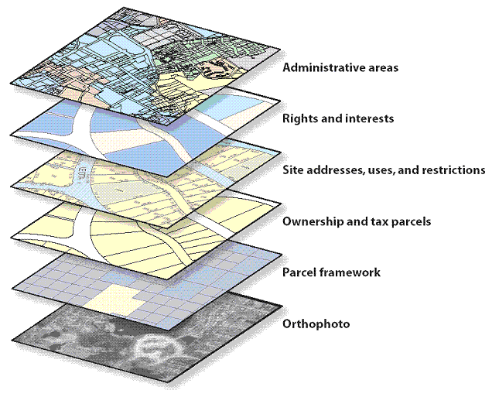
Spatial/Location Analytics concepts
Basemaps/Geographic Features
  Layers
  Points, Lines, Polygons,
  Rasters, Imagery
Source:http://www.getdomainvids.com/keyword/gis%20layer/

Slide 3
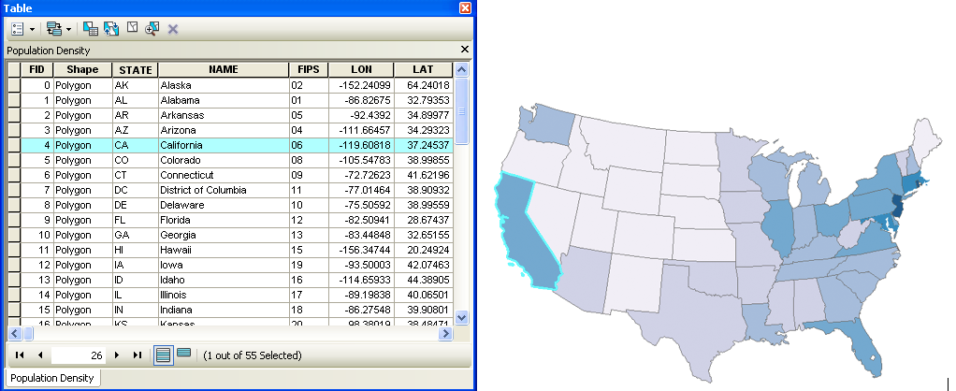
Spatial and non-spatial Data
Spatial Data is “information about the locations and shapes of geographic features and the relationships between them, usually stored as coordinates and topology”
Attributes are the “nonspatial information about a geographic feature usually stored in a table and linked to the feature by a unique identifier. For example, attributes of a river might include its name, length, and sediment load at a gauging station.”
(Source, ESRI: http://support.esri.com/en/knowledgebase/GISDictionary/search
Screenshot of an attribute table and a linked map in ESRI’s ArcMap™ program (Source: https://www.e-education.psu.edu/geog160/node/1930)

Slide 4
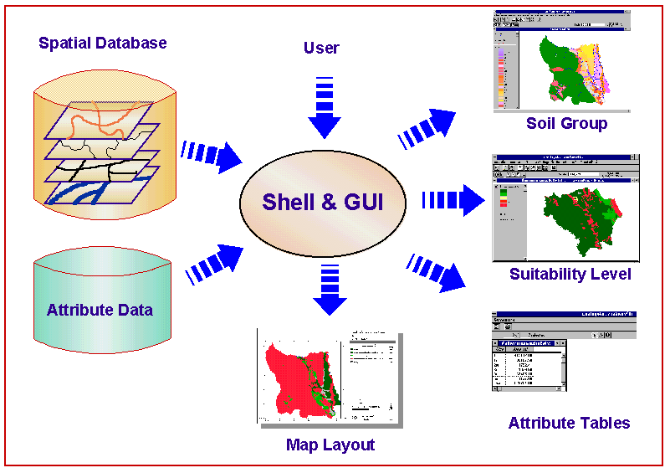
Enterprise Data
Databases efficiently store spatial data and attributes for
  visualization,
  processing,
  updating,
  real-time transactions, etc.
Many enterprise database development systems have spatial components (ESRI, MySQL, Oracle)
Source: http://www.mcc.cmu.ac.th/research/DSSARM/SoilSys/soilsys.html

Slide 5
How is spatial data changing? Volume, Velocity, Variety!
Basic spatial data types increasing in the 3 V’s (Volume, Velocity)
  Vector (points, lines, polygons)
  Raster (images, weighted pixels)
  Graph (network)
Source: Michael R Evans, Dev Oliver, Viswanath Gunturi, and Shashi Shekhar. Spatial Big Data: Case Studies on Volume, Velocity, and Variety. In Big Data: Techniques and Technologies in Geoinformatics. 2014 by CRC Press.
New sources of data
  Social Media
  Location Based applications (e.g. geotagging)
    Cameras, RFID
    Crowd sourced data
    GPS enabled devices
  Real-time sensors
  UAV (Drone) image analysis
  Radar
  LiDAR

Slide 6
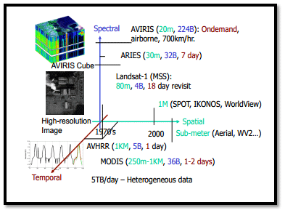
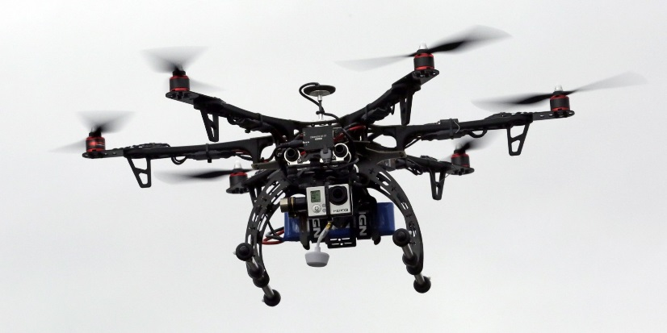
Sources of Geospatial Big Data: Raster
Source:http://www.gislounge.com/empowering-gis-big-data/
UAV(Drone) images
LiDAR for 3D analysis
Remote Sensing (satellite date)
Source:http://www.thedroneinfo.com/what-is-a-drone/

Slide 7
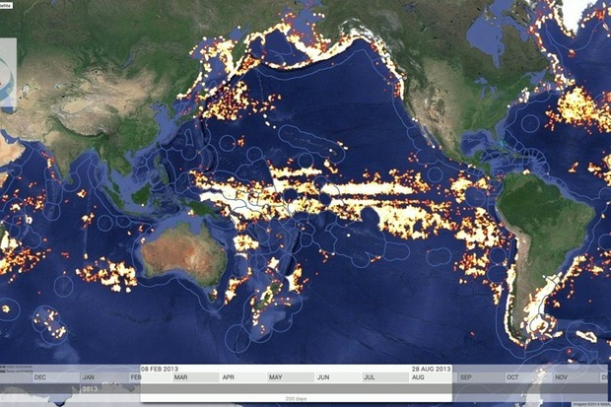
Sources of Geospatial Big Data: Vector
http://www.computerworld.com/article/2847660/google-taps-cloud-big-data-and-satellites-to-track-overfishing.html
GPS Tracking
Real-time Sensing/Monitoring
  Example: Using ship traffic signals to track fishing activity
Geolocation data
  Social Media
  Crowd Sourcing

Slide 8
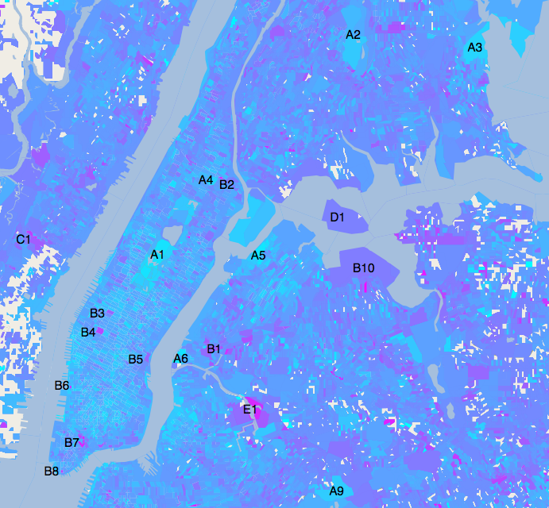
Social Media:
Spatial Sentiment Analysis
Develop a model based on the positive or negative aspects of tweets (or blogs)
For example, analyzing NYC, 600,000 Tweets
Can have both spatial and temporal aspects.
Datasets
  non-relational
  Very large (“Big”)
Source: http://www.necsi.edu/research/social/newyork/
Cyan represents the most positive sentiment and magenta the most negative

Slide 9
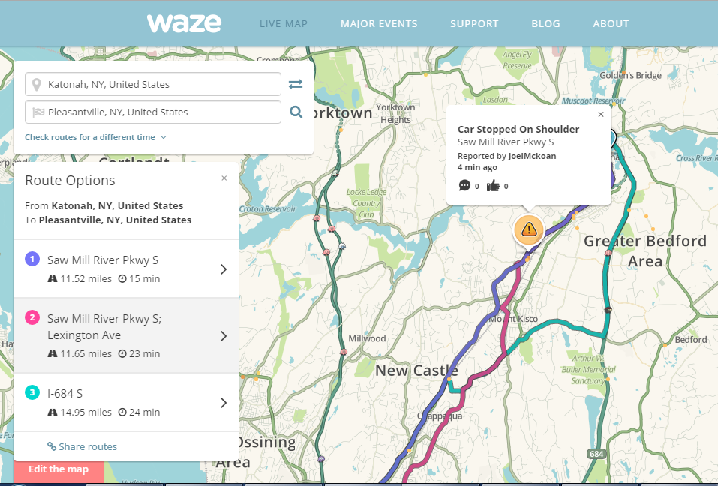
Crowd Sourcing:
Traffic Data (Waze)
Waze is a mobile app which receives user data on traffic in real-time
  Routes
  Events (accidents)
Builds navigation “intelligence”

Slide 10
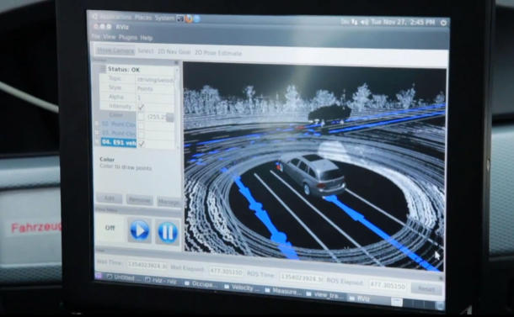
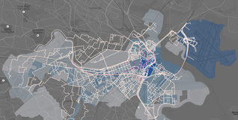
Network Data (Graph)
MIT Big Data Boston Traffic Challenge analyzed 2.3 million taxi rides
https://cee.mit.edu/news/releases/2014/humnet-lab-mit-big-data-challenge
Transportation routing
Navigation
  For example, Each of Here’s cars collects around 140GB of data a day, comprising LIDAR and image data
  Source: http://battellemedia.com/archives/2013/09/else-9-9-star-trek-level-stuff.php

Slide 11
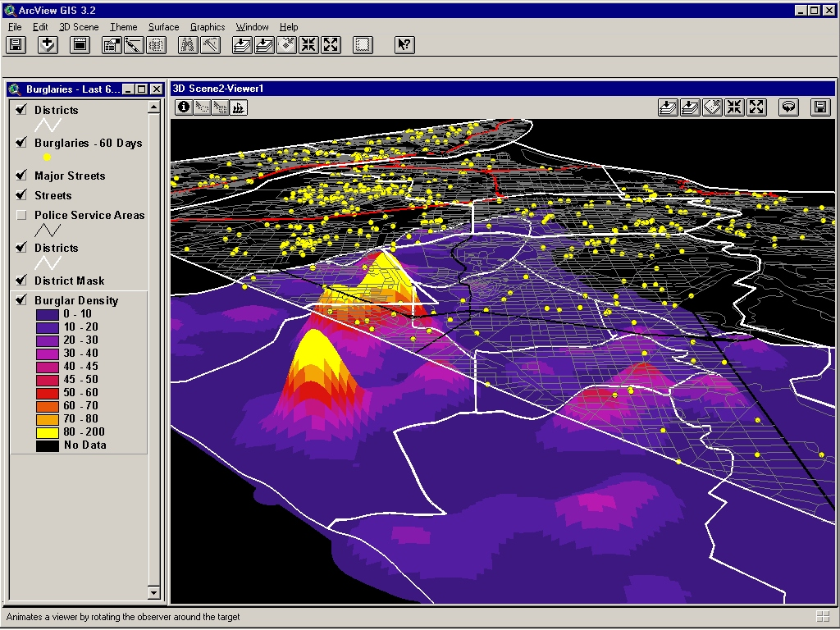
Traditional Spatial Analysis is more than looking at a map
Show Trends and Patterns
Show relationships between features and layers
Perform proximity analysis
http://www.geo.hunter.cuny.edu/~dougwill/crime/the_district/web_site/ep5/ep5.htm

Slide 12
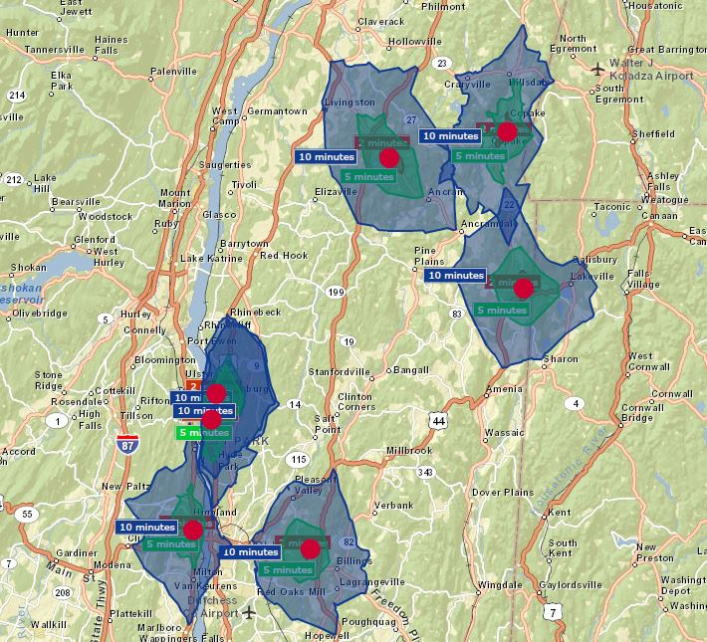
How does the increase in data effect Spatial Analysis
Basic Analysis and Techniques
  Visualization (Thematic Maps)
  Selecting by attribute and location
  Analyzing Proximity (Density, Buffers)
  Uncovering Patterns
  Analyzing Change (Time)
  3D Models
Very large data sets for existing and emerging data sources require special processing:
  Large web/network based data repositories
  High performance hardware
  New software techniques (e.g. Hadoop/MapReduce)
  Cloud-based services

Slide 13
Analytical Methods
For spatial/geographic data
For Big Data
For Geo-Big Data

Slide 14
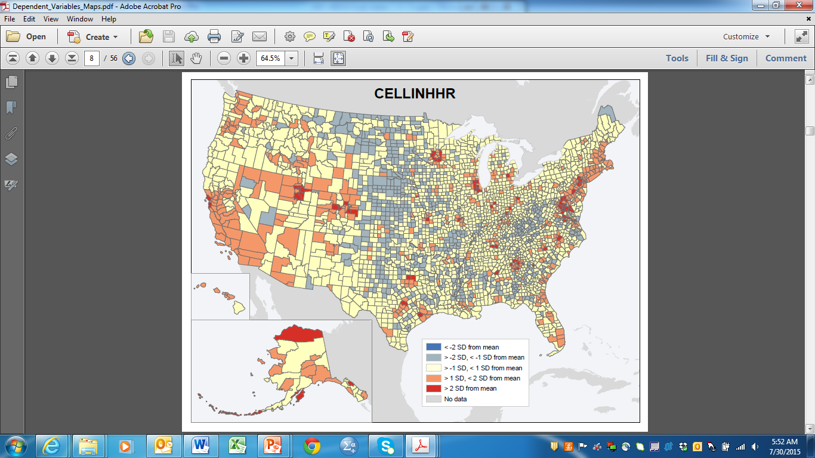
Pitfalls of Spatial Data
Convention statistical analysis imposes assumptions on data:
  Samples have to be random.
Spatial Data is “special”: almost always violates this assumption.
Spatial autocorrelation (SA): data from locations proximate to one another are more likely to be similar than data from locations far apart.
Non-random variation of spatial phenomena ➔ usual parameter estimates based on samples will be biased towards values prevalent in regions favored in the sample scheme.

Slide 15
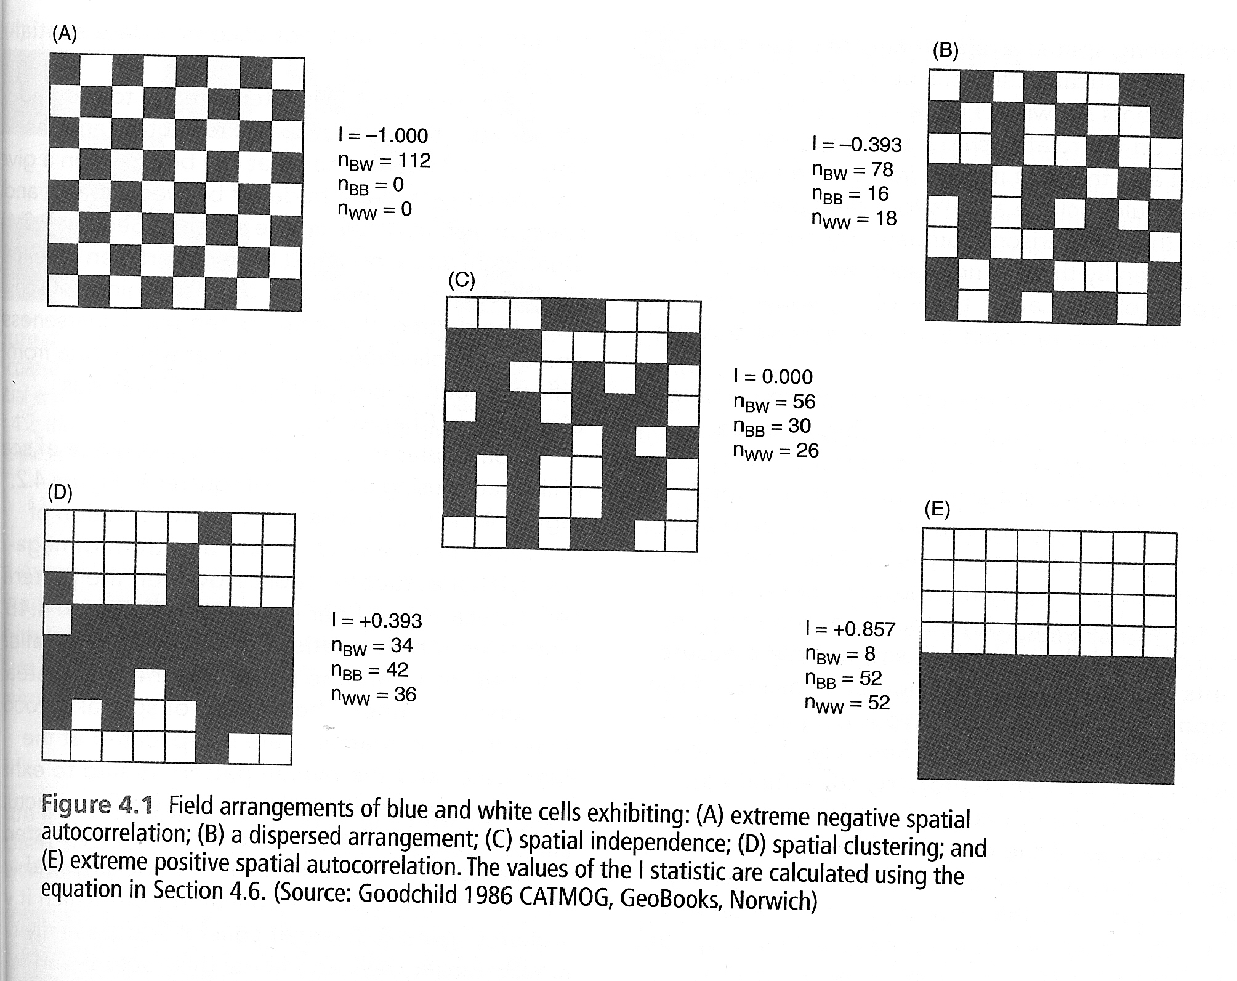
Spatial Autocorrelation Patterns Measured by Moran’s I
Source: Longley, P. et al. (2011). Geographic Information Systems & Science, Wiley, p. 103.

Slide 16
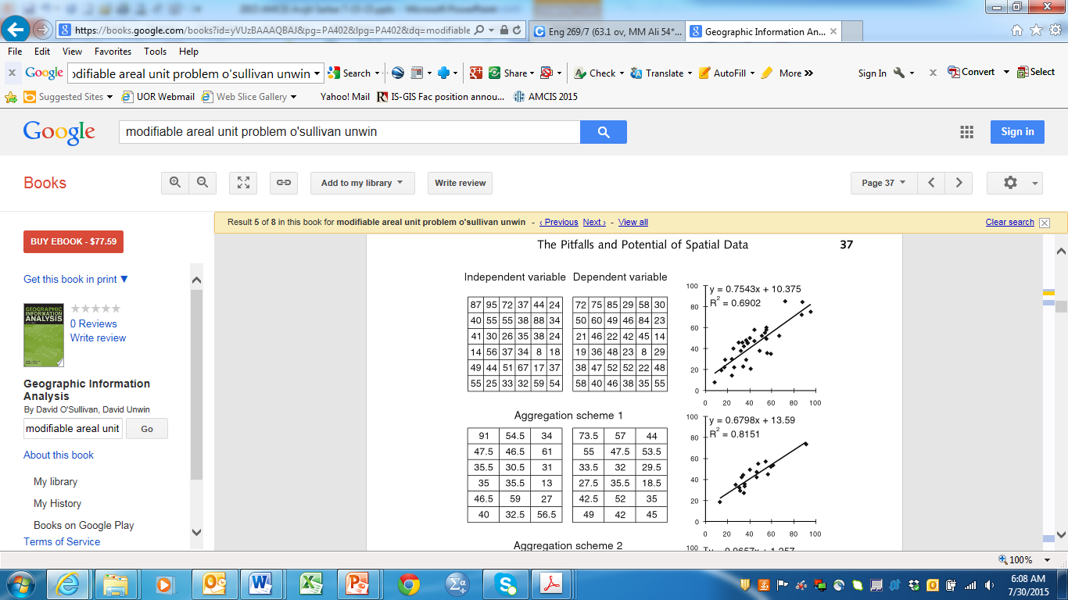
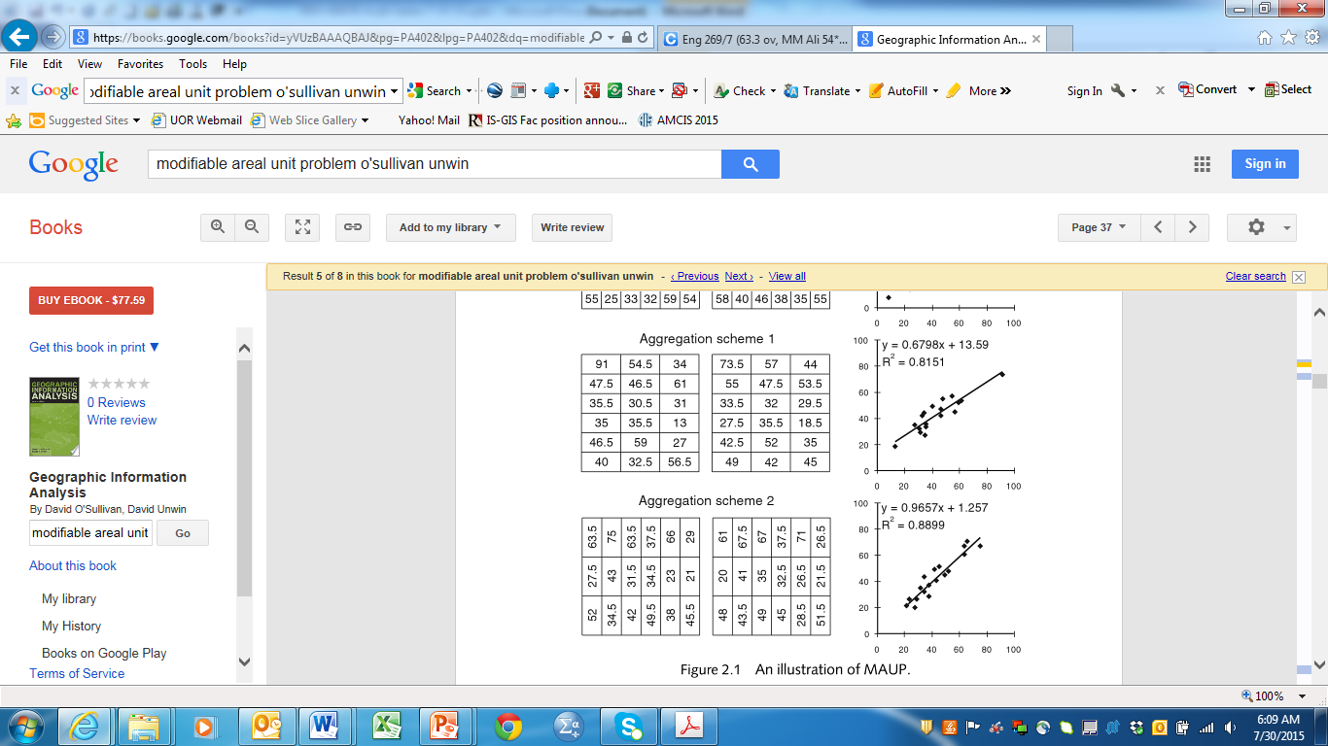
Modifiable Areal Unit Problem (MAUP)
Often spatial data are aggregates of data compiled at a more detailed level.
  e.g. census: household data, yet reported at county, metro, state level.
MAUP presents challenge in standard multivariate analysis.

Slide 17
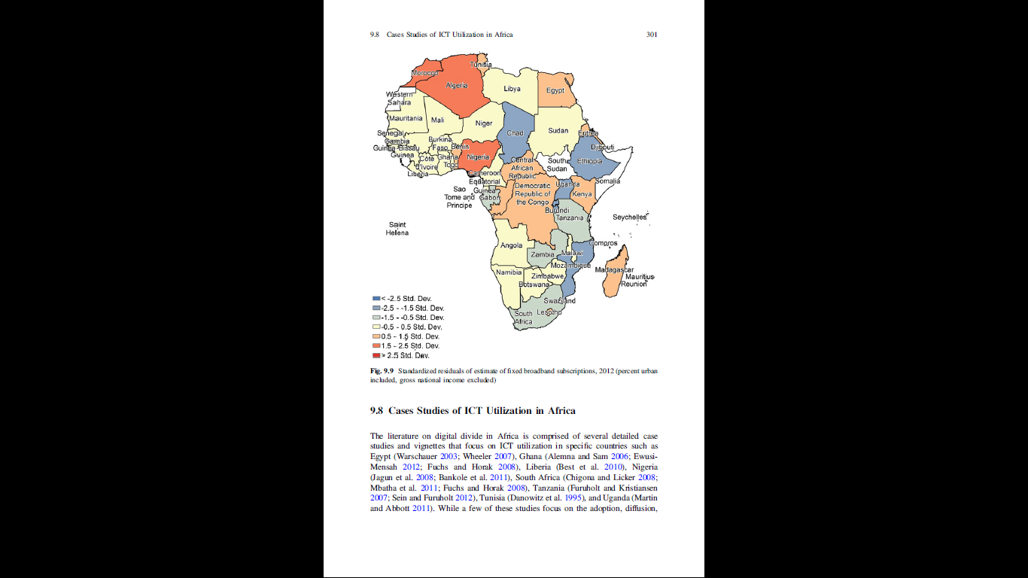
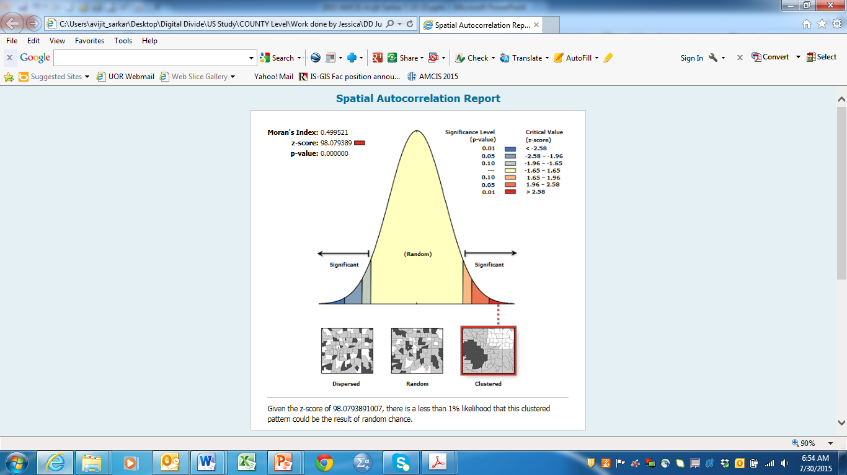
Multi-Variate Analysis with GeoData
Coefficients have the expected sign.
No redundancy among explanatory variables.
  Multi-collinearity: VIF <= 5.
Residuals are normally distributed.
  The residuals of a good model should be normally distributed with a mean of zero.
  Jarque-Bera Test statistically significant:
    Biased model ➔ Results are not reliable ➔ Key missing variable.
Residuals are not spatially autocorrelated.
Coefficients are statistically significant.
Strong Adjusted R-Squared value.

Slide 18
Analytical Techniques for Big Data
Statistical Inference
Widespread preference for visual analytics
Machine Learning

Slide 19
Statistical Inference with Big Data
Statistical Inference: generalizing results from smaller samples to much larger populations.
Big Data: analyze entire population of data, simply because technology makes it possible?
Any need to worry about – probability that observed results represent the population?
Sampling still important:
  In cases where it is infeasible to survey the entire population;
  For analyzing and examining complex, multivariate relationships.

Slide 20
Visual Analytics
Pervasive, enable descriptive analytics.
Easy to understand & interpret.
Maps: help explore geographic patterns in Geo-Big Data, provide basis for location analytics.
However:
  Not well-suited to expressing complex multivariate relationships (ill-suited for predictive or prescriptive analytics).
  Big Data = Small Math hypothesis!
    Effort to capture & structure Big Data so great, that little time or energy left to do complex, multivariate stats on it.

Slide 21
Machine Learning
Rapidly finding the model that best fits a dataset (e.g., genetic programming).
Advantage: Quickly produces models that explain and predict relationships in Big Data.
Disadvantage: Difficult to interpret and explain results
  Important to spend time to understand and examine possible relationships between variables.

Slide 22
Machine Learning on Geospatial Big Data
Main assumptions of Machine Learning:
  Data independent and have identical distributions.
Geo Big Data: Autocorrelation – both spatial and temporal.
Machine Learning:
  Supervised Learning: classification, interpolation, prediction.
  Unsupervised Learning: Clustering/Grouping, Anomaly Detection.
  Feature Learning: Extraction of features from data for learning purposes.

Slide 23
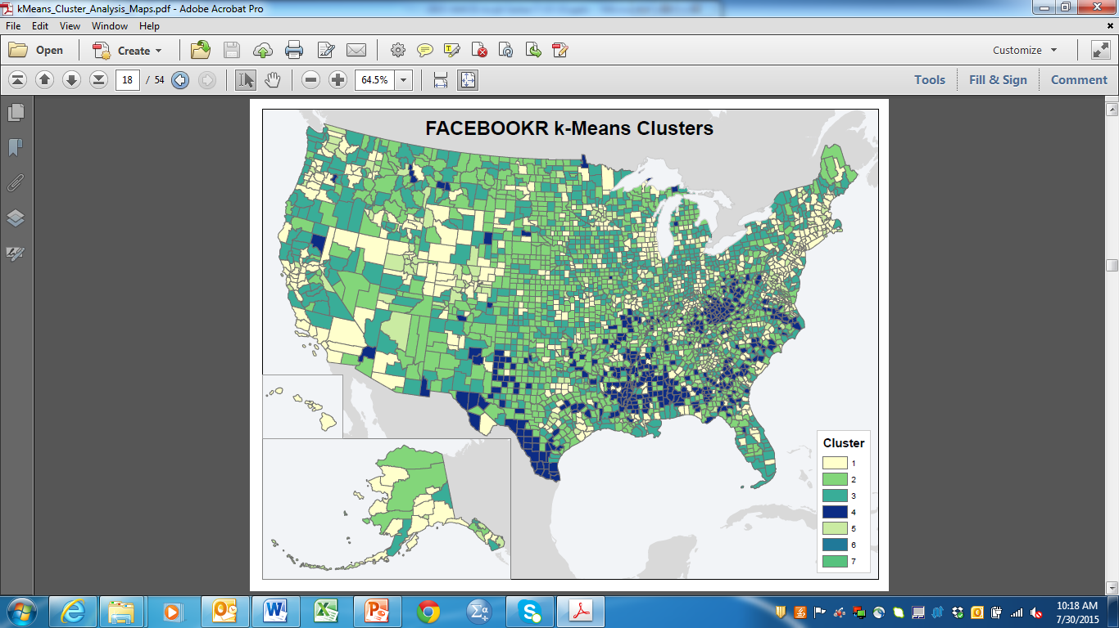
Machine Learning Algorithms used in Geospatial Community
Supervised Learning | Unsupervised Learning | Feature Learning
Linear regression | K-means clustering | Autoencoder
Logistic regression | Hierarchical clustering | Restricted Boltzmann Machines (RBM)
Artificial neural networks | Self-organizing map
K-nearest neighbor | Principal Components Analysis
Decision Trees | Linear Discriminant Analysis

Slide 24
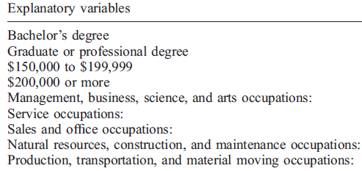
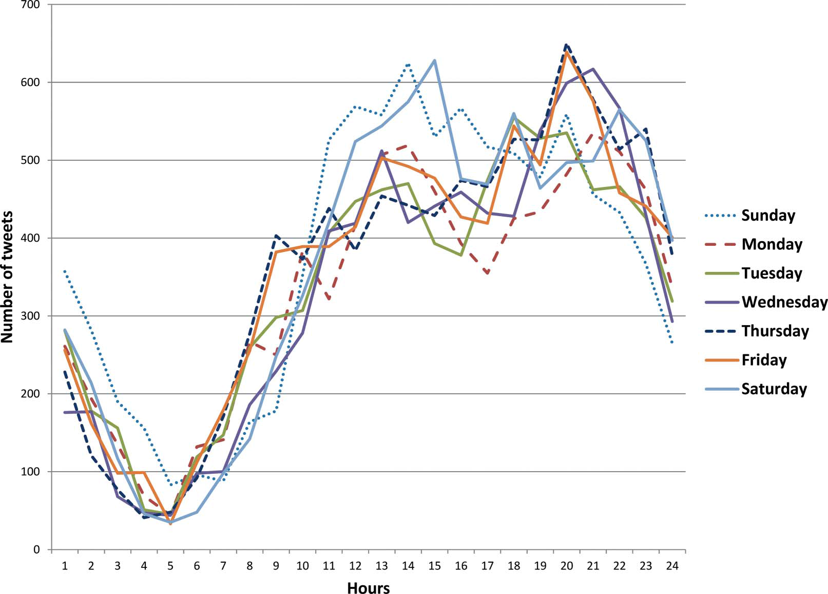
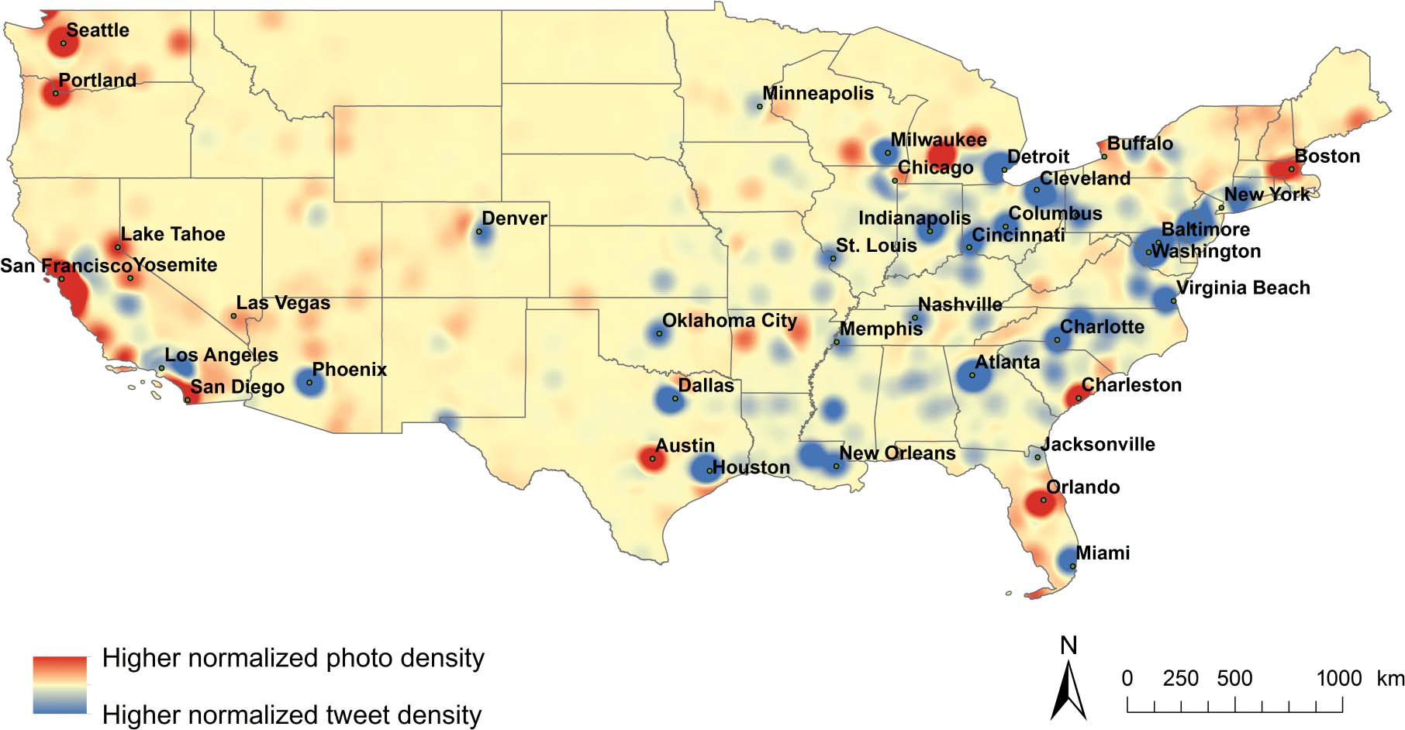
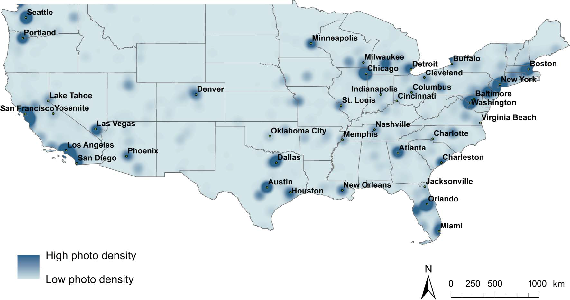
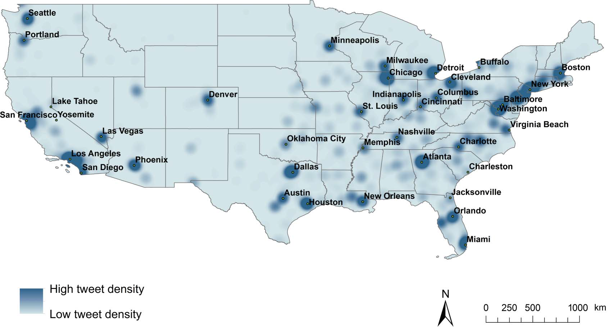
Big Data Location Analytics Case Studies: Spatial, temporal, socio-economic patterns in use of Social Media
Li, L., Goodchild , M.F. & Xu, B. (2013) Spatial, temporal, and socioeconomic patterns in the use of Twitter and Flickr, Cartography and Geographic Information Science, 40:2, 61-77.
Georeferenced Tweets Timechart
Georeferenced Photos Timechart

Slide 25
GIS & Social Media Analytics
Power outage after hurricanes
  Using GIS and Twitter, analysts were able to collect and analyze geo-tagged tweets that referenced the power outages.
  By normalizing the frequency of tweets against the population density, GIS analysts could map power failure across Manhattan.
  Instead of building a system of dedicated sensors or smart meters, analysts were able to use common devices like phones, existing communications networks, and GIS to track the outages.

Slide 26
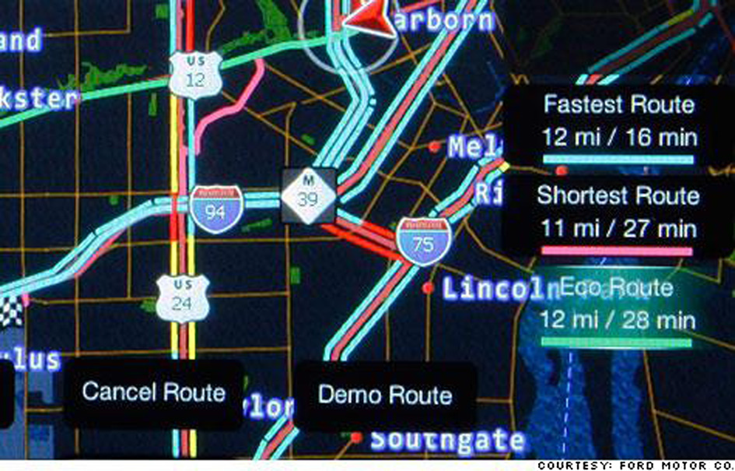
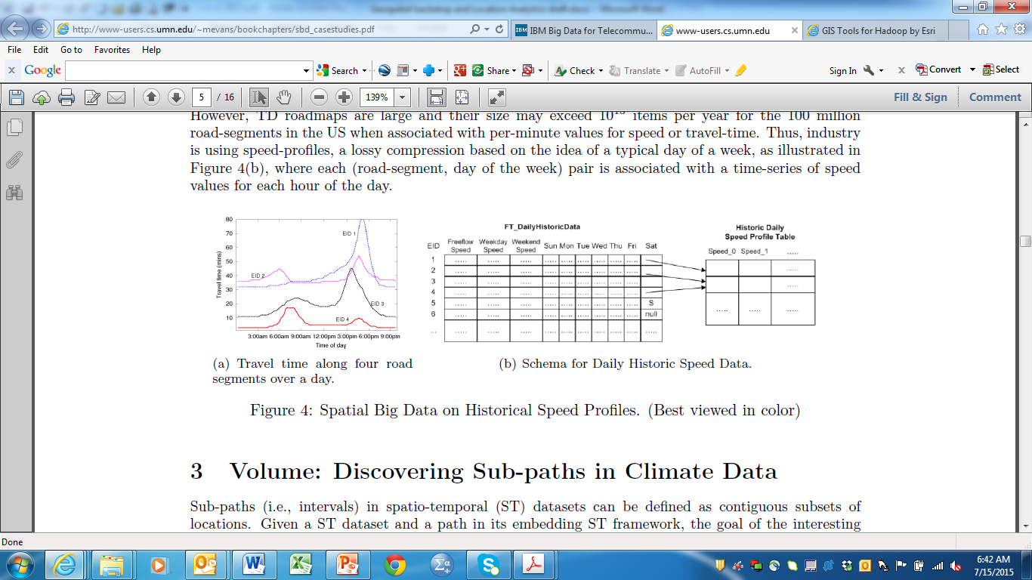
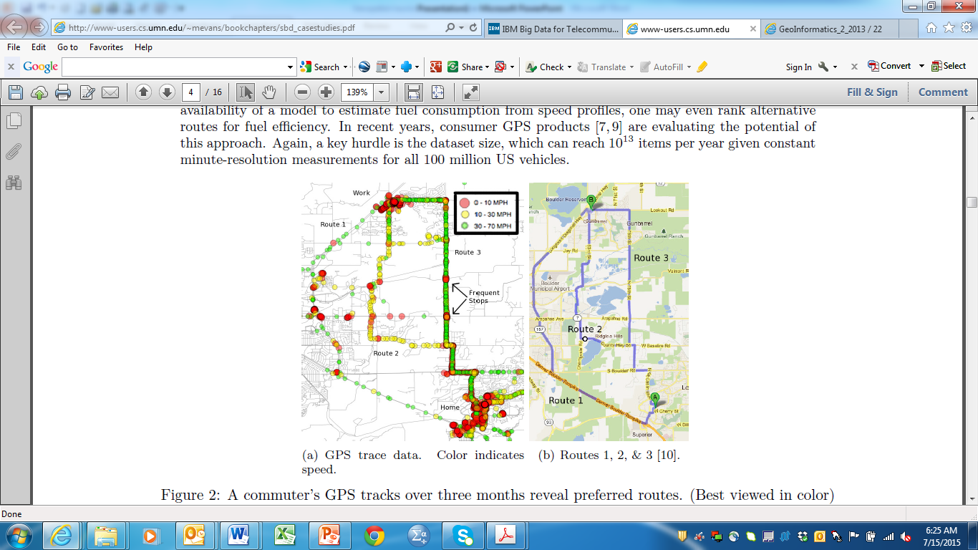
BDLA for Smart Planning in Transportation
Jae-Gil Lee, Minseo Kang (2015). Geospatial Big Data: Challenges and Opportunities, Big Data Research, 2(2), 74-81.
Eco-route
Minimizes fuel consumption rather than travel time or travel distance.
Eco-routing tries to find a route that avoids congestion, idling at red lights, turns and elevation changes, and so on.
Compared to using the “Fastest Route” option, Ford researchers told that using the “Eco Route” option reduced fuel consumption by as much as 15% in some of their vehicles.
Technology available in some Ford vehicles.
Volvo
Recently announced a program to build 1,000 smart cars that would share information with other vehicles to warn them about slippery road conditions.
http://inform.tmforum.org/strategic-programs-2/open-digital/2015/07/esris-jack-dangermond-on-geo-analytics-and-iot-we-are-limited-only-by-our-collective-imaginations/
Key hurdle: Dataset size, which can reach 10¹³ items per year given constant
minute-resolution measurements for all 100 million US vehicles.

Slide 27
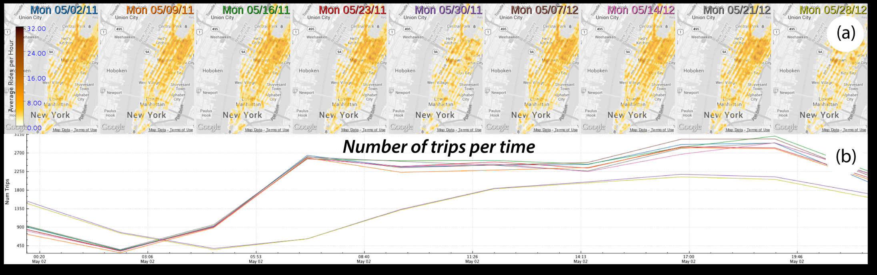
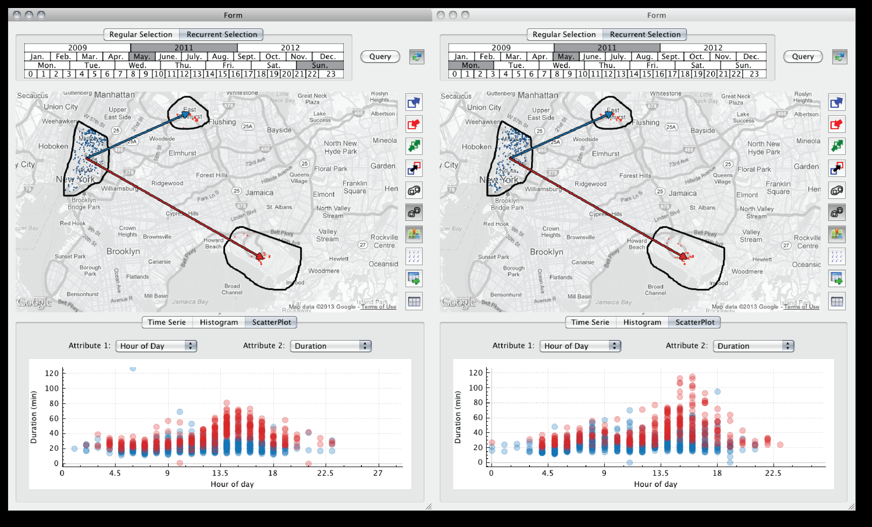
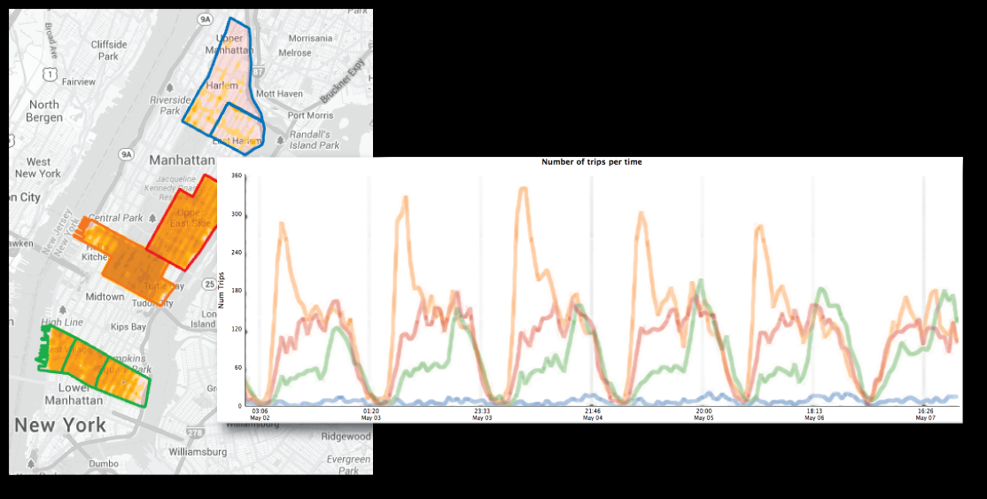
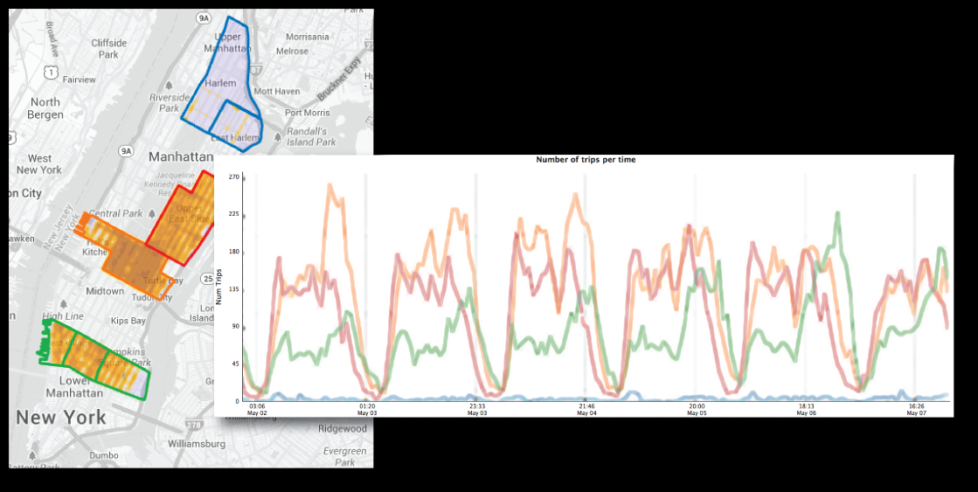
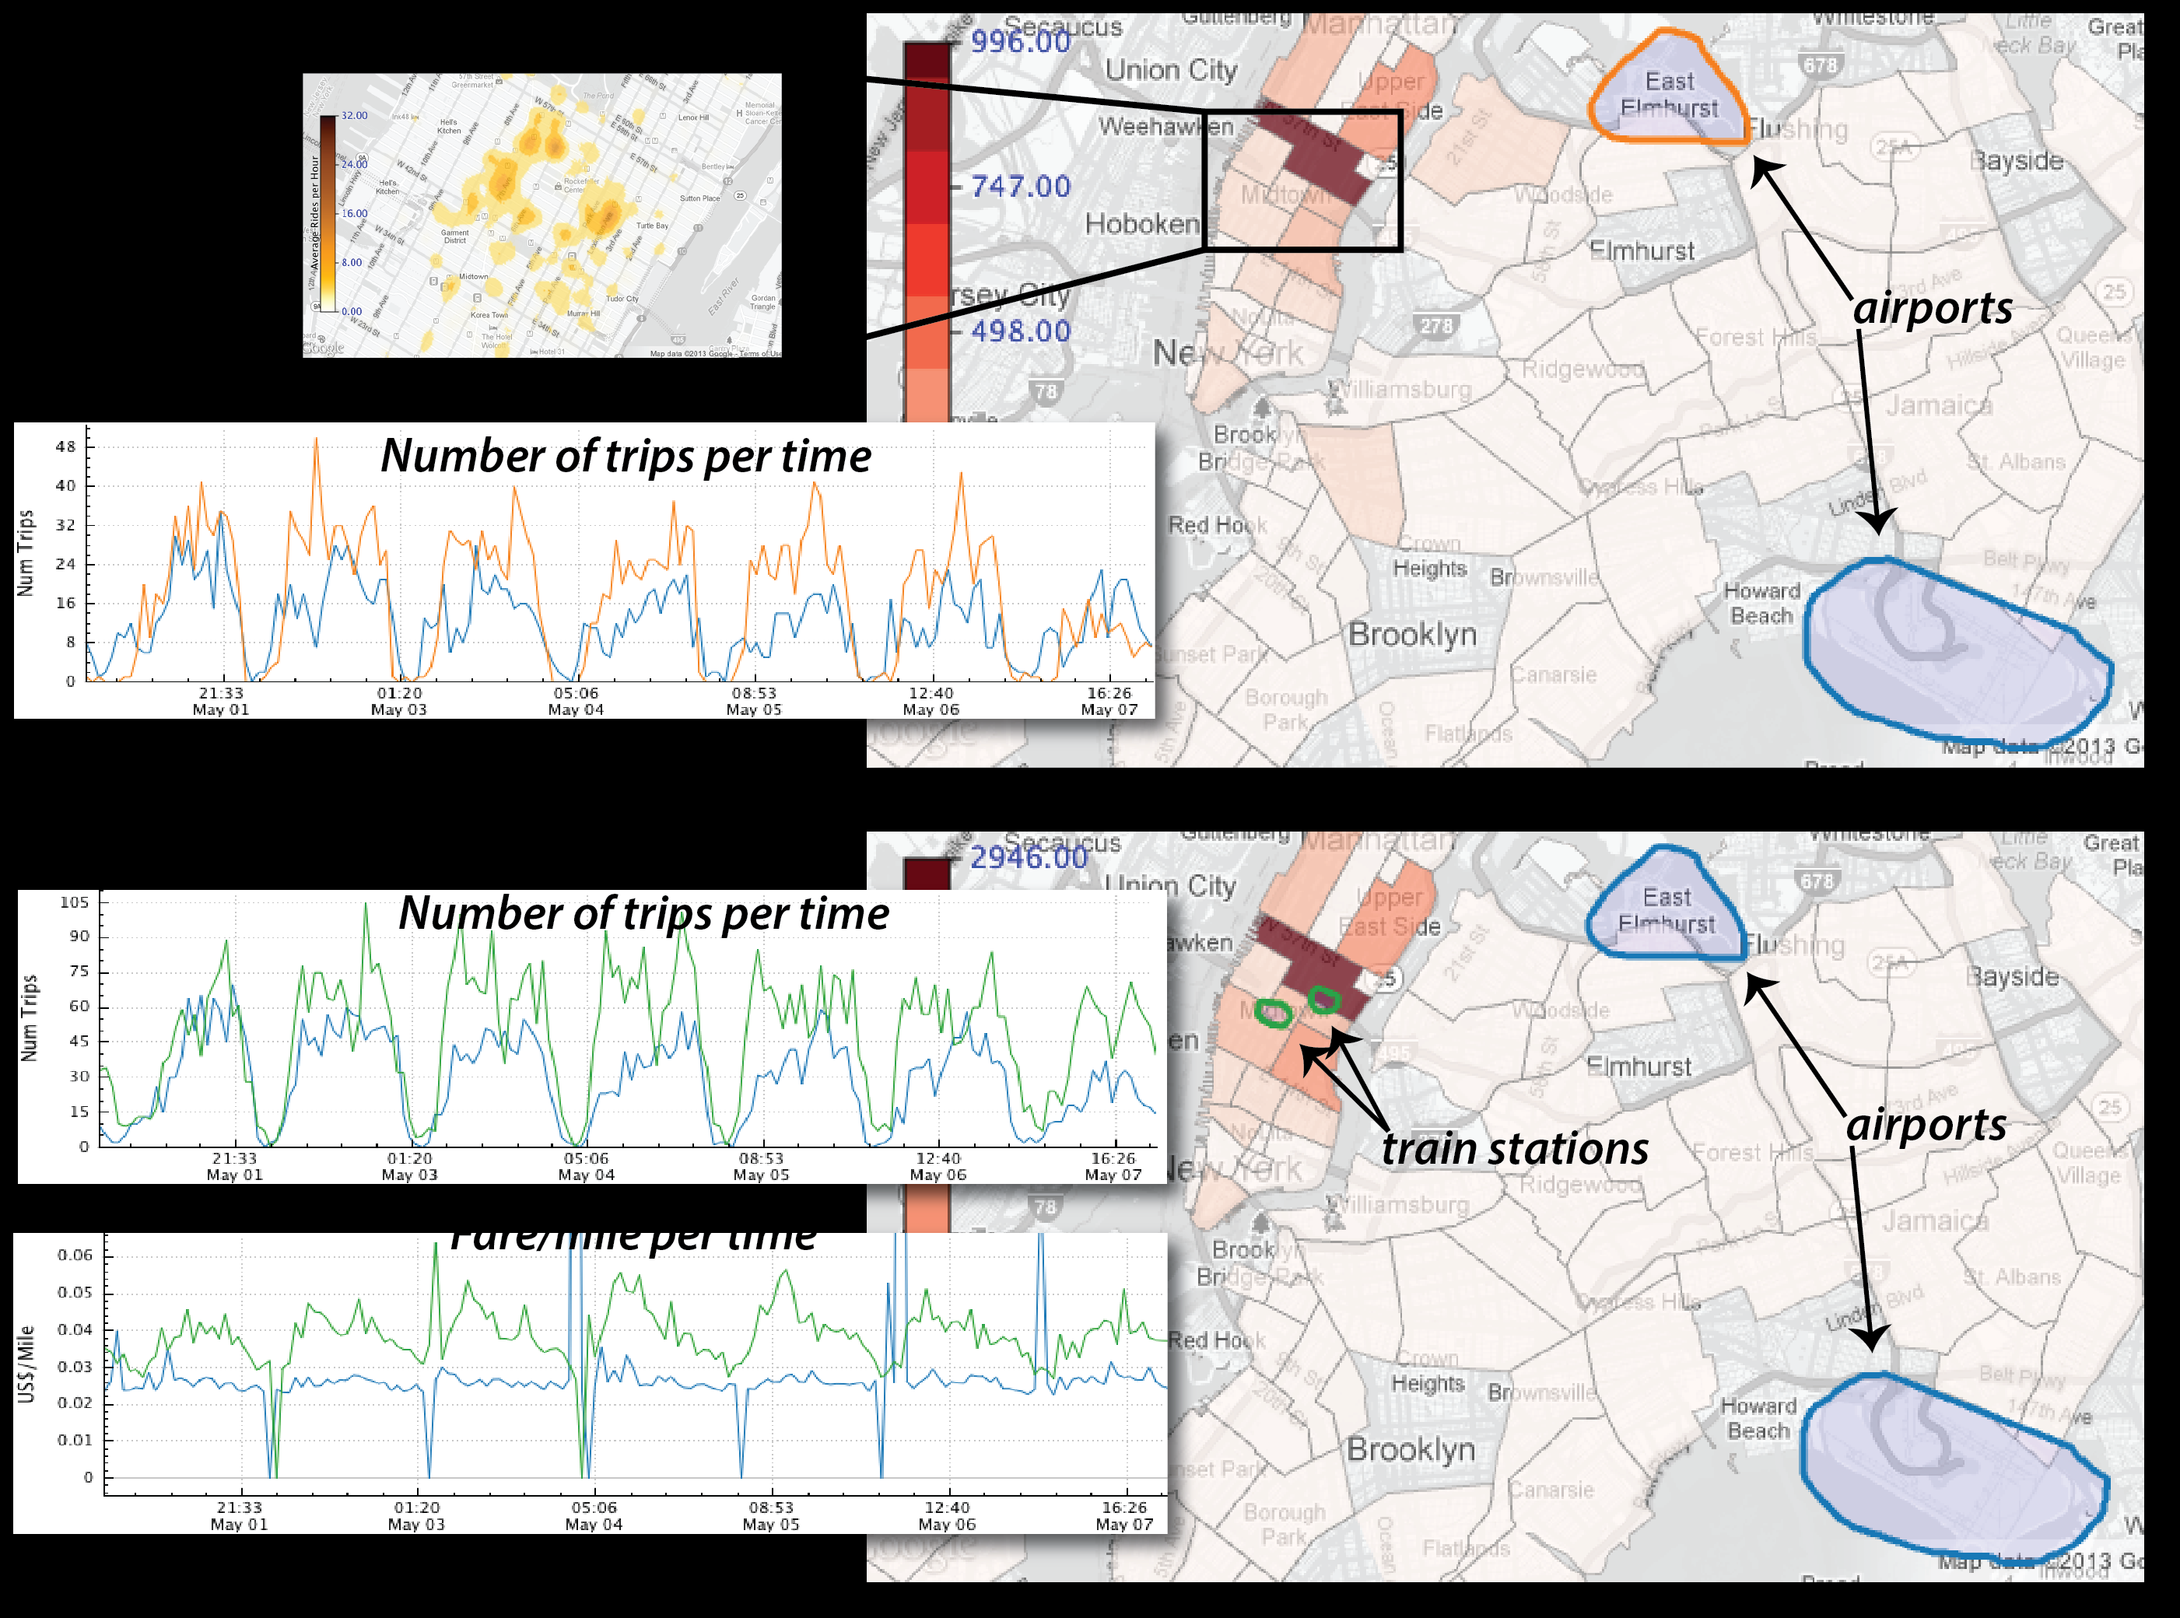
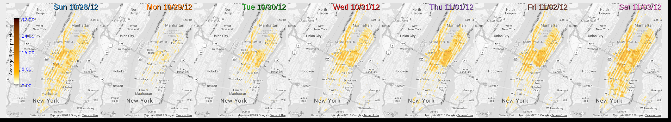
Taxis as Sensors of City Life
Ferreira, N., Poco, J. Vo, H., Freire, J. and Silva. C.T. (2013). Visual Exploration of Big Spatio-Temporal Urban Data: A Study of New York City Taxi Trips. IEEE Transactions on Visualization and Computer Graphics 19, 12 (December 2013), 2149-2158.
Pickups
Dropoffs

Slide 28
Taxis as Sensors of City Life: Decision-Making Implications
Underserved regions
Service coverage at transportation hubs
Service during days of week vs weekends
Service during times of day
Impact of natural disasters: extent of disruption & implications
Possibility of ride-sharing: Uber?

Slide 29
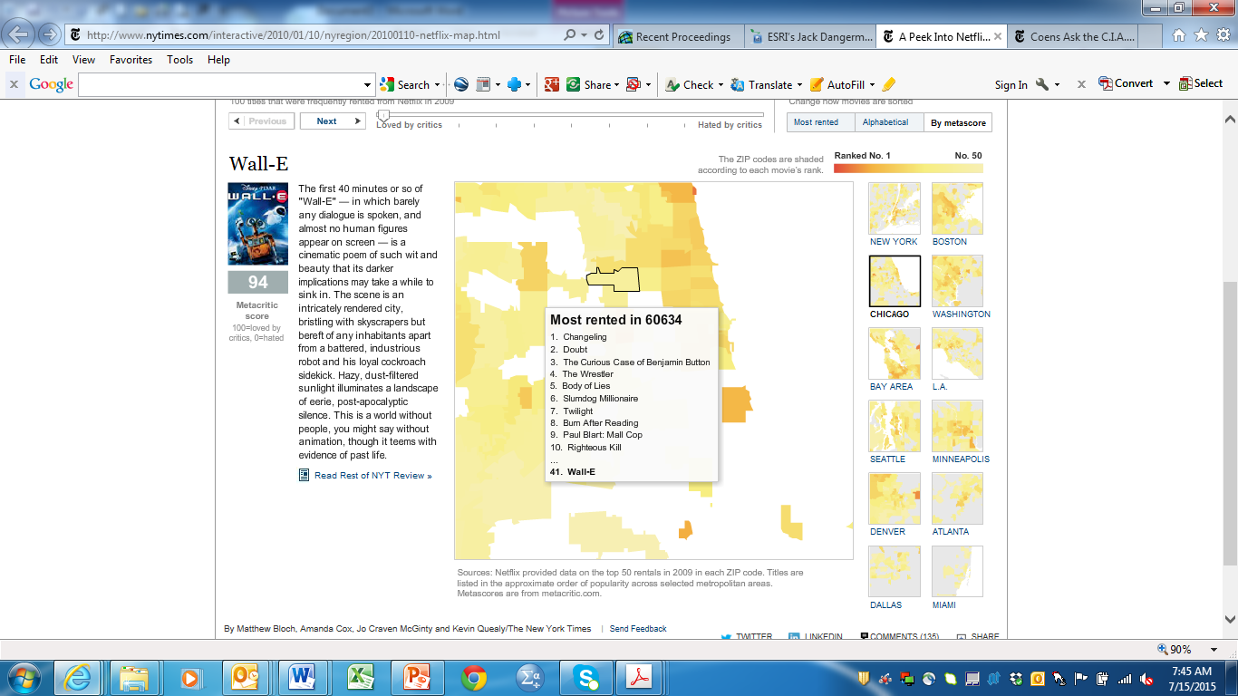
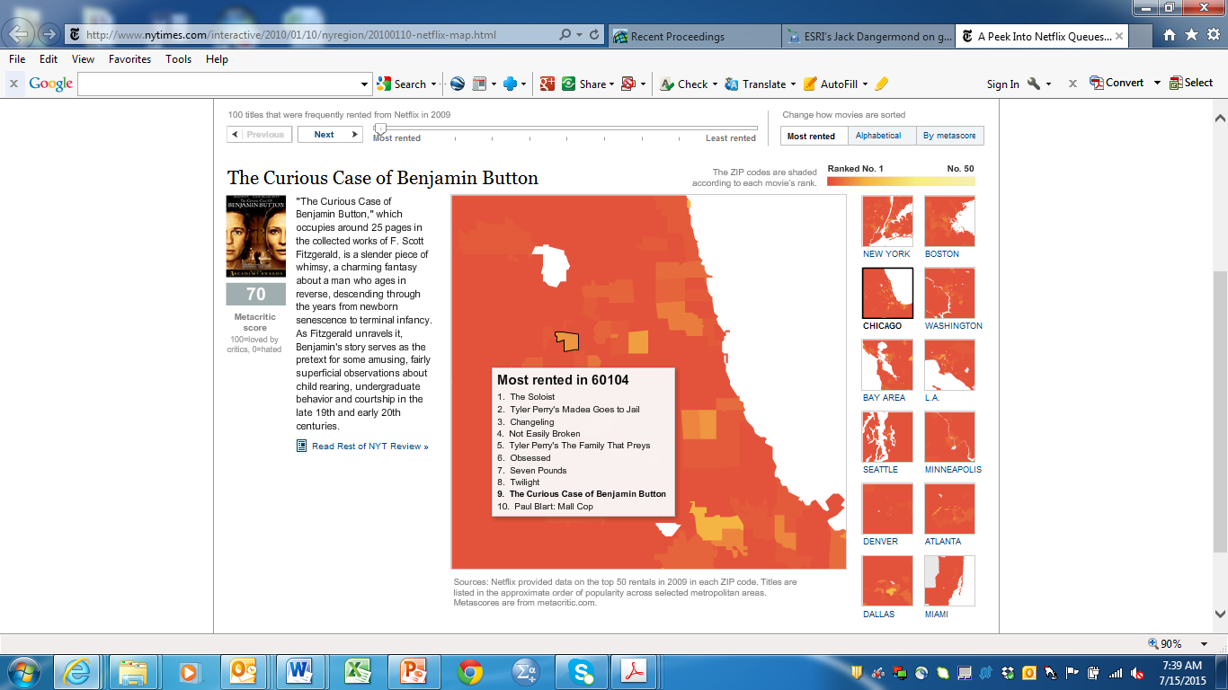
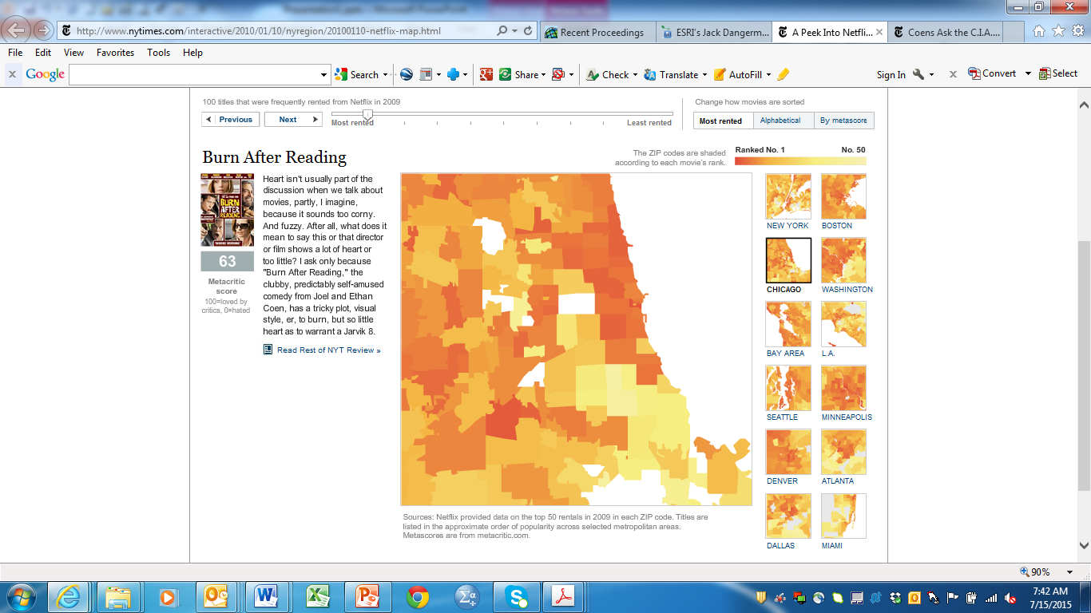
A Peek Into Netflix Queues http://www.nytimes.com/interactive/2010/01/10/nyregion/20100110-netflix-map.html

Slide 30
Key Takeaways
Traditional and new sources of spatial data increasing in the 3 V’s
There are emerging and evolving technologies and techniques for spatial analysis and analytics
Analytical Methods for Spatial Big Data
  Spatial and temporal autocorrelation plagues Geo Data – Big & Small!
  Diagnostic testing required for multi-variate analysis to ensure spatial bias is detected and regression assumptions are met.
  Big Data “theoretically” enables analysis of entire population, but samples still matter – especially in academic research, also to account for prohibitively large computational time.
  Machine Learning methods increasingly used for Geo Big Data: quick & dirty!

Slide 31


