Slide 1
GIS & SA in business curriculum
Segment 2
Hindupur Ramakrishna & Avijit Sarkar
University of Redlands
School of Business
Workshop on
Geographic Information Systems
International Conference on Information Systems
Auckland, NZ
December 2014

Slide 2
Segment objective
Now that the relevance (and value) of GIS and SA for business has been established, how should we get it across to the students in business schools & IS/IT schools/programs?
Why?
Where?
How?
When?

Slide 3
Organizational/Business Decision Making
Art?
Science?
Examples
Allocating resources (Service/technician, bank tellers, ..)
Wine quality ratings
eBay auction end times
Overbooking at airlines
Credit card offers (% APR, cash offer, cash back, …)
Choice of advertisements
Picking/packing items at warehouses
Loading/unloading trucks
Displaying items at grocery stores
Cart size at Costco
Loan processing at banks
Notes:
Discuss whether DM is art or science.
Using the examples, discuss what types of decision could be science.
What aspects/parts could be science.
Discuss evolution from art to science.

Slide 4
Organizational/Business Decision Making
Examples
Allocating resources (Service/technician, bank tellers, ..)
Wine quality ratings
eBay auction end times
Overbooking at airlines
Credit card offers (% APR, cash offer, cash back, …)
Choice of advertisements
Picking/packing items at warehouses
Loading/unloading trucks
Displaying items at grocery stores
Cart size at Costco
Loan processing at banks
Art?
Science?
Seat-of-the pant
Expertise
Evidence-based
  Available
  Experimentation
Analysis-based
Decision support
Decision making
Modeling
Static
Dynamic
Mathematical
Statistical
+ Spatial
(including geography)
Techniques
Hypothesis testing
ANOVA
Regression
Cluster analysis
Deterministic
Stochastic
Outcome characteristics (the bottom line)
Efficiency (faster, cheaper, …)
Effectiveness
Notes:
Under at discuss problem solving methods, group problem solving, etc. (Management course material)
Discuss expert systems (we typically discuss in an IS course) for expertise based DM.
Discuss Decision Support Systems (DSS) as part art and part science in DM.
When we move from art to science (for a particular class of decisions) the outcome should be improved efficiency or effectiveness.
Evidence could be something that already exists or something collected (on demand) through experimentation.

Slide 5
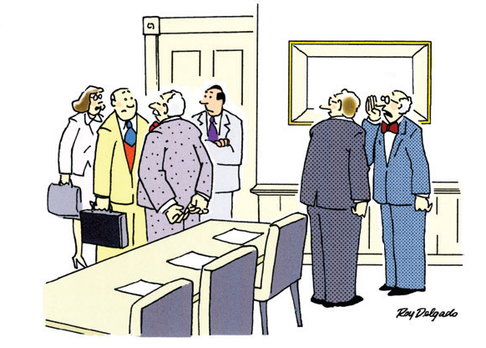
We did a Pareto analysis, a grid analysis, a decision tree, a force field analysis...and then the boss decided to go with his gut.”
HBR (Jan. 2006)

Slide 6
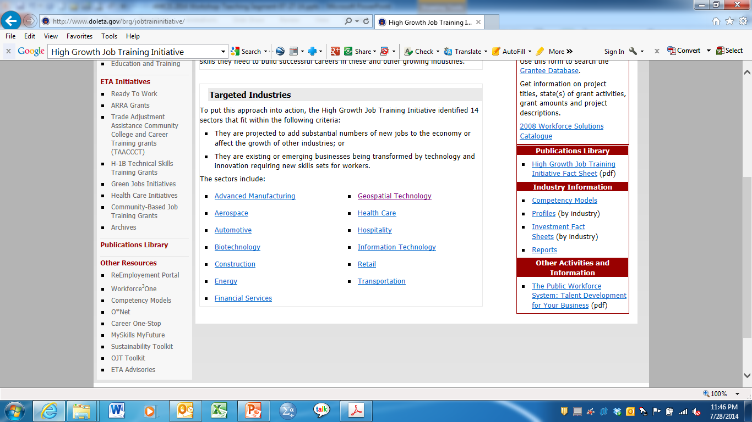
Why GIS & SA in B-Schools?
A lot of business data is inherently spatial.
  Almost 75 – 80% of all business data possesses a location component or can be georeferenced (Bossler, 2002).
High Growth Job Training Initiative (2003)
Geospatial Industry growth & revenues headed north!
  Worldwide market forecast to grow 65% over the next 5 years (Reiser, 2009).
  Global GIS market CAGR 9.60% by 2016 (Oxera, 2013).
  Global geospatial industry brings in $270 billion in annual revenue (Oxera, 2013).
  Spurred by Big data (approx. $48 billion by 2018, Transparency Market Research) & Analytics.

Slide 7

Why GIS & SA in B-Schools?
Increasing availability and access to geospatial data through web (Wu, 2007) & mobile/other handheld devices.
Migration of GIS software and data into the cloud (Saas).
Businesses & Governments use GIS
  Sears, Nike, Proctor & Gamble, Petco, Starbucks, Peugeot Citroën Automobiles UK, Time Warner Cable, Willis group, Walgreens
  Many county, city, municipal governments
  Federal and state agencies
Geospatial workforce
  Estimated employment of 857,000 in 2008 (DiBiase et al, 2008).
  Expected to add approx. another 339,000 jobs (average growth of 7 – 13% per year) by 2018 (DiBiase et al, 2008).

Slide 8
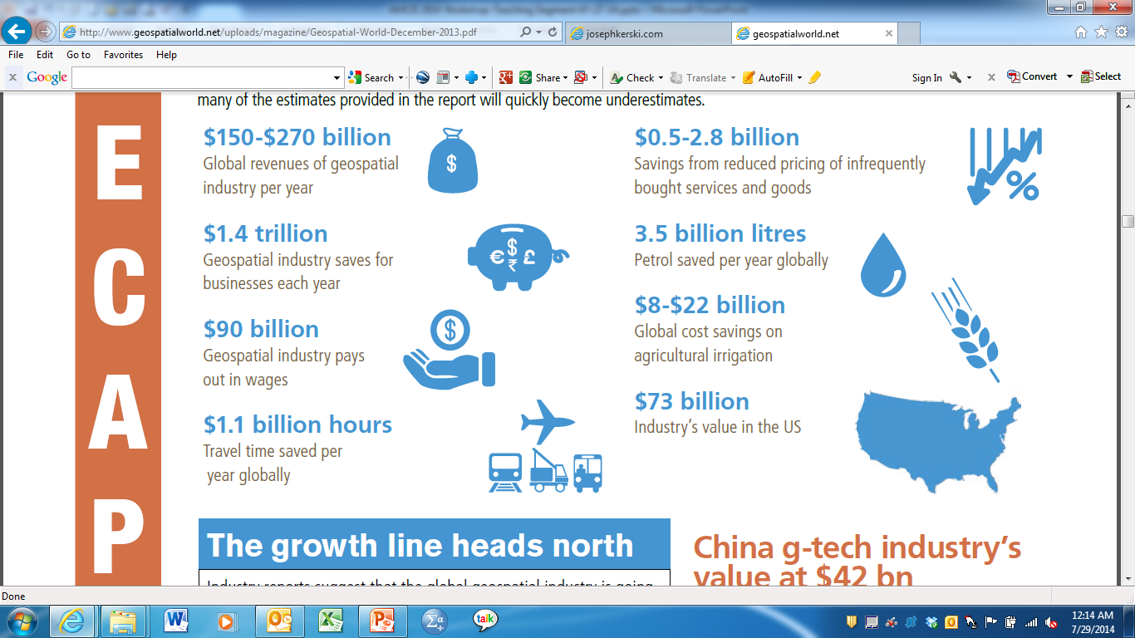

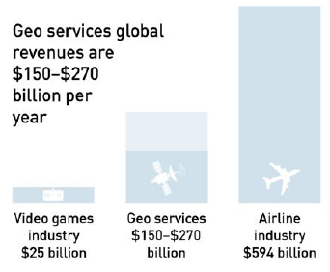
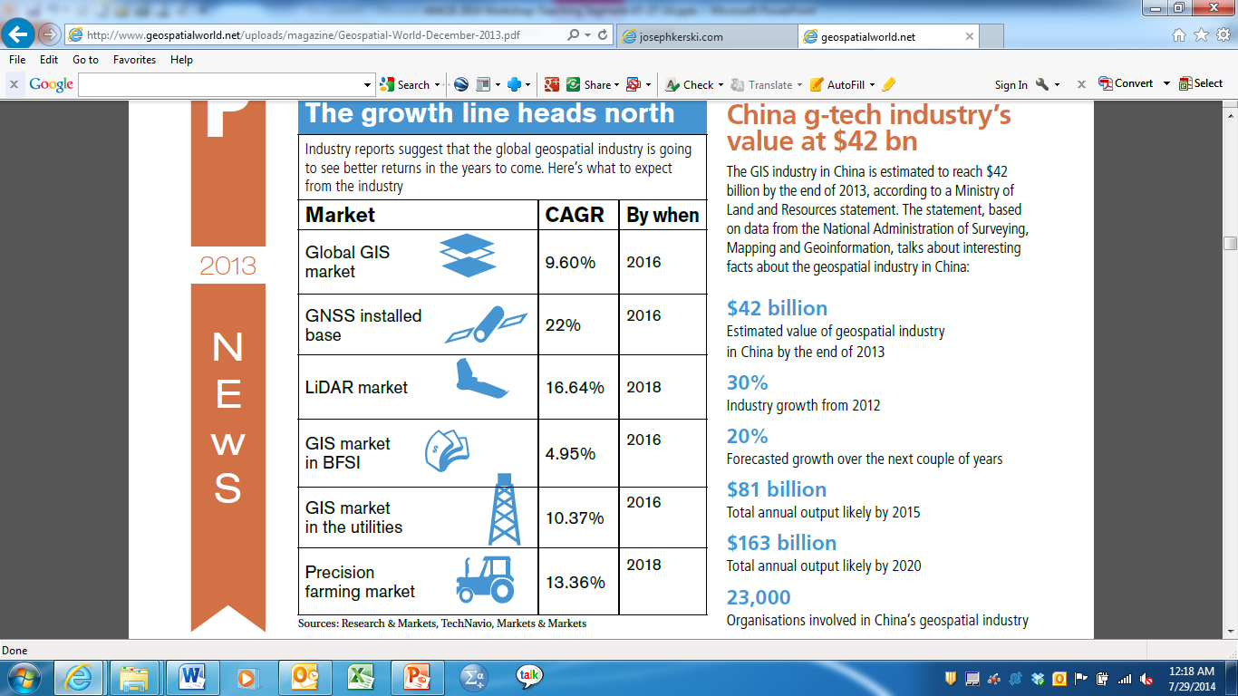
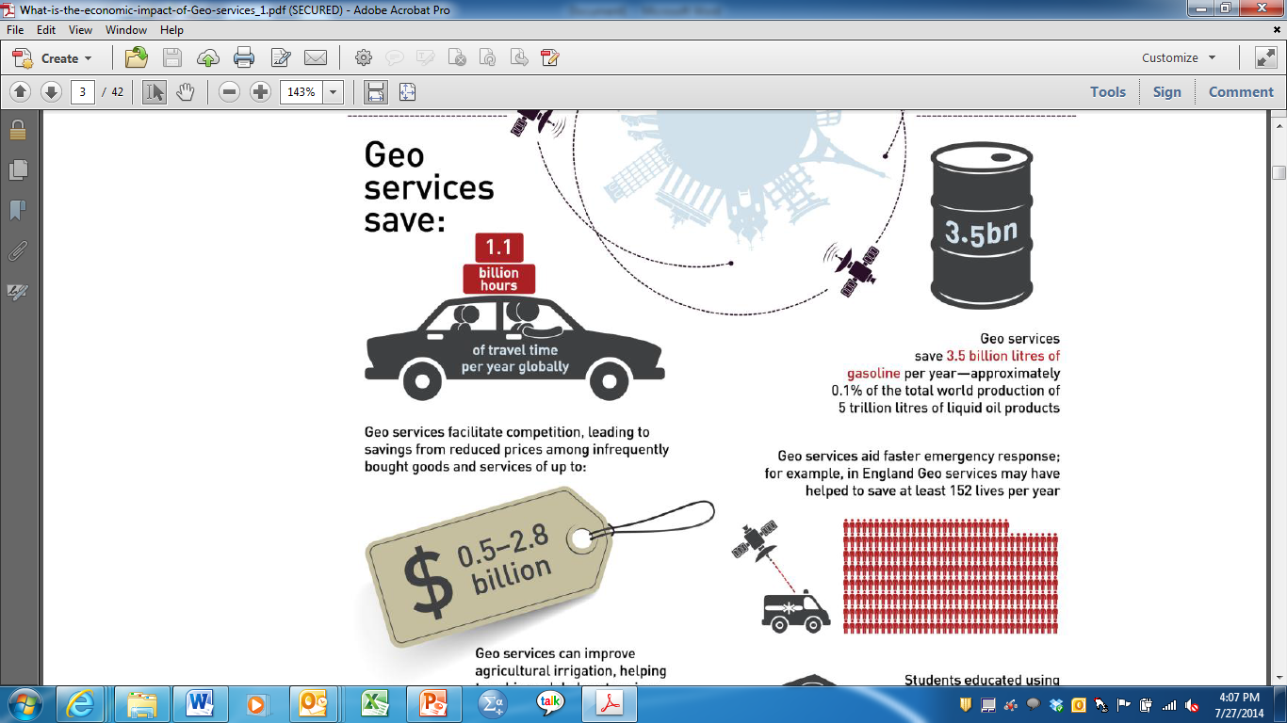
What is the economic impact of Geo?
(Oxera, 2013)

Slide 9
Status of GIS & SA Infusion in B-Schools
Infusion is sporadic – mainly in
Both at UG (few core, mainly elective) & graduate levels.
Earliest instances of infusion: mid-late 1990’s.
In IS/IT
  As part of courses in DSS, Management Support Systems.
  Generic standalone courses such as Business Geography, Introduction to Geospatial Science and GIS, Applications of GIS.
  Specialized standalone courses such as GIS Database Concepts, Programming GIS with Python, GIS Project Design, etc.
In Marketing
  Generic standalone courses such as Business GIS in Marketing, Geomapping Fundamentals, Using GIS for marketing Applications.
  Specialized standalone courses: Enterprise Business GIS, Global Marketing Management, Advanced Micromarketing
In OM/SCM/Logistics
  Specialized coursework in Distribution System Design & GIS, Tools and Techniques for Logistics Analysis
In Real Estate
  Specialized coursework in Economic Geography & GIS and Location Analysis.
IS/IT | Marketing | A few in OM/SCM/Logistics & Real Estate

Slide 10
Facilitators of integrating GIS & SA (Ramakrishna et al, 2010)
Resource factors | Administrative support factors | Other factors
Technology training and support for integration | Open to new ideas for curricular innovation | Expedient curriculum approval process
Release time/financial support for course revision | Responsive to the market | Good fit with the curriculum of the school/college
Faculty champion | Knowledgeable about GIS & SA
IS faculty interested in GIS & SA
Coverage time in courses
Teaching materials
Inhibitors
  NIMBY issue (I have too much to do in my courses, and, hence, can not add more material)
  Time needed to learn new tools and cost of tools
  Not getting credit for teaching enhancements (in research focused schools/colleges)
  Support – not available/not accessible

Slide 11
Select instances of GIS infusion as part of MIS curricula
East Carolina University (Mennecke, 1998)
  GIS Training imparted as significant part of a DSS course within B-school curricula.
  Students’ attitude about effectiveness of GIS as decision support tool and its role in business improved; however,
  Students did not develop positive perceptions about the benefit of GIS training on their careers.
Robert Morris University (Wu & Kohun, 2005)
  Two standalone GIS courses (focus on applications) developed in School of Communication & Information Systems: one grad & one UG.
  Build conceptual understanding of architectural model of GIS using exercises on basis GIS functions.
  Labs, equipment, data sources.
Angelo State University (Reames, 2006)
  Standalone UG course on Business Geomapping developed.
  Internal technology development seed grant acted as catalyst.
  GIS labs (dedicated 32 workstation MIS lab), case studies, independent project.

Slide 12
Modes of GIS infusion in MIS curricula
(Li, Wynne, Babb, 2009)
Kerski’s Dimensions of GIS Education (Kerski, 2008)

Slide 13
Strategies for creating GIS coursework in B-Schools (Shepherd, 2009)
Strategy | Description | Implemented at?
Service #1 (off-the-shelf) | Geography departments recruit business students into their mainstream GIS courses | Univ. of Florida
Service #2 (tailored) | Geography departments design & deliver GIS courses tailored for business students | Leeds Univ., UK
Collaboration | Geography & business departments collaborate to combine existing modules to create a hybrid business GIS course | West Chester Univ., PA
Transplantation | Geography faculty move to a business school (perhaps on a sabbatical) and develop embedded GIS courses | Middlesex Univ., UK
Buy-in | Business school faculty acquire & deliver an off-the-shelf module in business | NCGIA materials/modules
Home-grown | Business school faculty design & deliver GIS coursework for business students | Univ. of Redlands

Slide 14
Our Experience at University of Redlands:
UG Core Course in Business GIS
BUSB 433 GIS for Business (4): MAJOR TOPICS
Geographic information and its importance in organizations.
Basics of GIS and maps.
Decision-making with GIS.
Spatial and non-spatial data: sources, accuracy, availability, costs.
Spatial analysis and modeling.
Investment in and value of GIS.
GIS software and how to use it effectively.
Case applications of GIS and spatial data in businesses.
Management of GIS in organizations.
Ethical issues.
The future of geographic information and spatial decision making.
Hands-on experience: ESRI’s Business Analyst Online

Slide 15
Our Experience at University of Redlands:
MBA Emphasis in GIS
COURSE SEQUENCE
MGMT 631 Management and Organization Theory (4) MGMT 667 Business, Ethics and Society (4) BUAD 610 Contexts for Contemporary Business (4) BUAD 648 Applied Business Statistics (4) BUAD 641 Managerial Economics (4) BUAD 683 Information and Knowledge Management (4) MGMT 680W Marketing Management (4) * BUAD 659 Accounting for Managers (4) BUAD 660 Managerial Finance (4) BUAD 655W Global Business (4) * MGMT 650 Management Science and Decision Analysis (4) MGMT 697W Strategy Capstone (4) *
Emphasis courses provide disciplinary knowledge from a GIS context.
Hands-on experience: ESRI’s ArcGIS Desktop & BAO.
Steady enrollment in this emphasis although Finance emphasis is more popular.
Faculty: both full-time and adjunct with significant professional experience in GIS & consulting.
GISB 691W GIS for Marketing
GISB 692W Geog. Anal of Global Biz
GISB 693W GIS and Strategy

Slide 16
Three concrete examples (MBA)
Applied business statistics course (BA emphasis)
  GIS as a source of more (relevant) data
  GIS as a source of better data
Introductory MIS course
  GIS for conceptual understanding of relevance of geography for business decision making.

Slide 17
Overall…
Presence of a faculty champion.
IS faculty interested in Geotechnology & GIS.
Significant administrative buy-in & support.
Buy-in at faculty level encouraging, but a work-in-progress.
Expedient curriculum approval process.
Availability of software through ESRI’s campus site licensing.
Availability of reliable and persistent technology training and support.
A good fit with our overall curricula.
Proximity to ESRI.

Slide 18
Timing and placement (of infusion): Issues to consider
A designated “GIS & SA” course (Teaching and Learning about GIS, Kerski, 2008) or “GIS & SA across the curriculum” (Teaching with GIS, Kerski, 2008)
Teaching and Learning about GIS: Required course(s) or electives
Teaching with GIS: Which course(s) and how much coverage

Slide 19
Benefits of GIS education for students
(Bradbard & Fuller, 2012; Sinton, 2012)
Spatial thinking promotes critical thinking
Spatial literacy enhances quantitative literacy
Visualization & graphic skills enhanced
Problem-solving skills are positively impacted, especially if PBL approach is used in teaching
Provides opportunities for real world experience
Overall employability & salary potential (Oxera, 2013) positively impacted.

Slide 20
Benefits of GIS infusion: Institutional & faculty
(Bradbard & Fuller, 2012; Sinton, 2012)
Faculty
  Open frontiers for research (grants etc.), often interdisciplinary.
  Positive impact on motivation to emphasize “linking business and technology”, “practical application of course work,” and the importance of “challenge/problem solving” to students.
Institutional level
  Supports, often enables service learning mission.
    “Engaging in ‘real’ work of the world, where one can have a direct effect on improving people’s lives, is a tremendously powerful motivation to students.” (Sinton, 2012, pp.21)
  Competition for students within & between programs.
  Managing the business of the university.

Slide 21
Key Takeaways
Growth of Geospatial industry increasing rapidly.
GIS & SA in B-school curricula is novel.
Unlike ethics & global, geospatial still isn't a “cost of doing business” for B-schools, MIS/CIS programs.
Presents an opportunity for curricular innovation.
IS/IT & Marketing – business disciplines that have led infusion of GIS & SA in B-schools.
GIS education promotes spatial thinking: positive impact on critical thinking, problem solving, quantitative literacy.
One size (strategy) doesn't fit all!
  Analysis of external & internal environment is a crucial success factor!

Slide 22
References: GIS in Business School Curricula
Brickley, M., K. Micken, and B. Carr (2006) “Can GIS play a role in the business curriculum?”, in Proceedings of Northeast Decision Sciences Institute, San Juan, PR, pp. 21-24.
ESRI White Paper (2007) “Approaches to school of business GIS programs”, http://www.esri.com/library/brochures/pdfs/approaches-to-school.pdf (current July 14, 2013).
Estaville, L. E. (2007) “GIS and colleges of business: A curricular exploration”, Journal of Real Estate Literature, (15)3, pp. 443-448.
Johnson, M. L. (1996) “GIS in business: Issues to consider in curricular decision-making”. Journal of Geography, 95, pp. 98-105.
King, M., and A. Arnette (2011) “Integrating Geographic Information Systems in Business School Curriculum: An Initial Example”, Decision Sciences Journal of Innovative Education, 9(3), pp. 325-347.
Ramakrishna, H., A. Sarkar, and B. Vijayaraman (2010) “Infusion of GIS and spatial analysis in business school curricula: A status report”, Journal of Informatics Education Research, Spring/Fall, pp. 1-45.

Slide 23
References: Specific instances of GIS infusion in Business Schools
Boasson, E. (2006) “Teaching Object Oriented Geographic Information Systems (GIS) using Visual Basic: Spreadsheet Approach”, in The Proceedings of ISECON 2006, 23(3544), Dallas, TX.
Boasson, E., V. Boasson, and W. Tastle (2006) “A New Tool in IS Management: Geographic Information Systems”, Information Systems Education Journal, 4, pp. 3-9.
Erevelles, S. et al. (1999) “Incorporating geographic information systems into marketing education”, The Journal of Database Marketing, (6)4, pp. 357-371.
Evans, M., et al. (2002) “Future marketers: Future curriculum: Future shock?”, Journal of Marketing Management, (18)5/6, pp. 579-596.
McBane, D. (2003) “Getting the horse to drink: Teaching technology to marketing students”, Marketing Education Review, (13)2, pp. 1-6.
Miller, F. L., T. L. Holmes, and W. G. Mangold (2007) “Integrating geographic information systems (GIS) into the marketing curriculum”, Marketing Education Review, (17)3, pp. 49-63.
Miller, F., W.G. Mangold, and T. Holmes (2006) “Integrating geographic information systems (GIS) applications into business courses using online business geographics modules”, Journal of Education for Business, 82, pp. 74-79.
Reames, S. (2006) “Business geographic information systems - A course in business geomapping”, Information Systems Education Journal, (4)52, pp. 3-15.
Smith, C. D., C. J. Langley, and R. Mundy (1998) “Removing the barriers between education and practice: Tools and techniques for logistics management”, Journal of Business Logistics, (19)2, pp. 173-195.

Slide 24
Other Geo-Business References
ESRI (2013) http://www.esri.com/industries/business
Harris, R., P. Sleight, and R. Webber (2005) Geodemographics, GIS, and Neighborhood Targeting, Hoboken, NJ: John Wiley and Sons.
Miller, F. (2010) Getting to Know ESRI Business Analyst, Redlands, CA: ESRI Press.
Miller, F. (2007) GIS Tutorial for Marketing, Redlands, CA: ESRI Press.
Pick, J. B. (2008) Geo-Business: GIS in the digital organization, Hoboken, NJ: Wiley.
Pick, J. B. (2005) Geographic Information Systems in Business, Toronto, Canada: Idea Group Publishing.
The Business Geography Specialty Group of the AAG http://www.businessgeography.info/ (current July 14, 2013).

