Slide 1




Location Intelligence for Business
November 2016
Notes:
1

Slide 2



200+ offices, operations in 1,000 locations in 71 countries
Americas
EMEA
Asia-Pacific
Alpharetta, GA
Altamonte Springs, TL
Ann Arbor, MI
Atlanta, GA
Austin, TX
Baltimore, MD
Bellevue, WA
Bethesda, MD
Bogota
Boston, MA
Buenos Aires
Calgary
Charlotte, NC
Cherry Hill, NJ
Chicago, IL
Cincinnati, OH
Cleveland, OH
Columbus, OH
Curitiba
Dallas, TX
Denver, CO
Detroit, MI
East Bay, CA
El Segundo, CA
Fort Lauderdale, FL
Fort Worth, TX
Hartford, CT
Hasbrouck Heights, NJ
Houston, TX
Indianapolis, IN
Iselin, NJ
Jacksonville, FL
Kansas City, MO
King of Prussia, PA
Las Vegas, NV
Los Angeles, CA
Los Angeles (West), CA
Los Angeles (North), CA
Melville, NY
Memphis, TN
Mexico City
Miami, FL
Minneapolis, MN
Mississauga
Monterrey
Montgomery, AL
Montreal
New York, NY
O’Hare, IL
Orange County, CA
Orlando, FL
Ottawa
Palo Alto, CA
Parsippany, NJ
Philadelphia, PA
Phoenix, AZ
Pittsburgh, PA
Portland, OR
Raleigh, NC
Richmond, VA
Rio de Janeiro
Sacramento, CA
San Antonio, TX
San Diego, CA
San Francisco, CA
San Juan, PR
Santiago
São Paulo
Seattle, WA
St. Louis, MO
Stamford, CT
Tacoma, WA
Tampa, FL
Tijuana
Toronto
Vancouver
Vienna, VA
Virginia Beach, VA
Washington, DC
Westmont, IL
Abu Dhabi
Aktau
Amsterdam
Antwerpen
Barcelona
Bath
Belgrad
Berlin
Birmingham
Bristol
Brüssel
Bukarest
Budapest
Cardiff
Casablanca
Danzig
Den Haag
Dschidda
Dubai
Dublin
Düsseldorf
Edinburgh
Eindhoven
Exeter
Frankfurt
Glasgow
Göteburg
Hamburg
Hannover
Helsinki
Istanbul
Johannesburg
Kairo
Kiew
Köln
Krakau
Leeds
Leipzig
Lissabon
Liverpool
London - Canary Wharf
London - City
London - South East
London - Heathrow
London - West End
Luxemburg
Lyon
Madrid
Manchester
Mailand
Moskau
München
Newcastle
Norwich
Nottingham
Paris - Central
Paris - La Defense
Paris - Plessis-Robinson
Paris - Saint-Denis
Prag
Pressburg
Riad
Rom
Rotterdam
Sevilla
Southampton
Split
St. Petersburg
Stockholm
Stuttgart
Tel Aviv
Ütrecht
Valencia
Warschau
Zagreb
Zürich
Adelaide
Admedabad
Auckland
Bali
Bangalore
Bangkok
Brisbane
Canberra
Chandigarh
Chengdu
Chennai
Chongqing
Christchurch
Coimbatore
Delhi
Guangzhou
Gurgaon - Haryana
Gurgaon - South City
Hanoi
Ho Chi Minh City
Hong Kong - Kowloon
Hong Kong - Quarry Bay
Hong Kong - Queensway
Hyderabad
Jakarta
Johor Bahru*
Kalkutta
Kochi
Kuala Lumpur*
Macau
Manila
Melbourne
Melbourne - Glen Waverley
Mumbai - Lower Parel
Mumbai - Worli
Osaka
Pattaya
Penang*
Peking
Perth
Phuket
Pune
Qingdao
Sapporo
Seoul
Shanghai - Pudong
Shanghai - Puxi
Shenyang
Shenzhen
Singapore
Sri Lanka
Surabaya
Sydney
Sydney - Brookvale
Sydney - Liverpool
Sydney - Mascot
Sydney - North Sydney
Sydney - Parramatta
Taipei
Tianjin
Tokyo - Nagatacho
Tokyo - Sanbancho
Wellington
* Services in Malaysia
are provided through
a strategic alliance with
Jones Lang Wootton
Malaysia
JLL provides commercial real estate strategy, services and support to organizations around the globe.
Founded in 1790

Slide 3
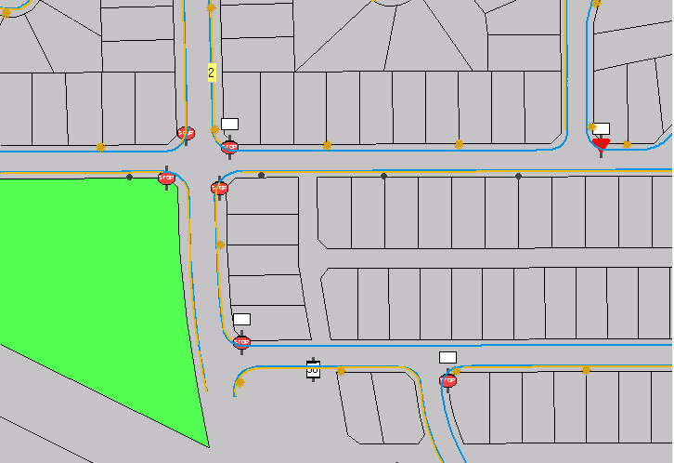
GIS/GPS and Local Government (Civiccenter)
Locating physical Assets using GIS and GPS to create
a maintenance management and asset system

Slide 4
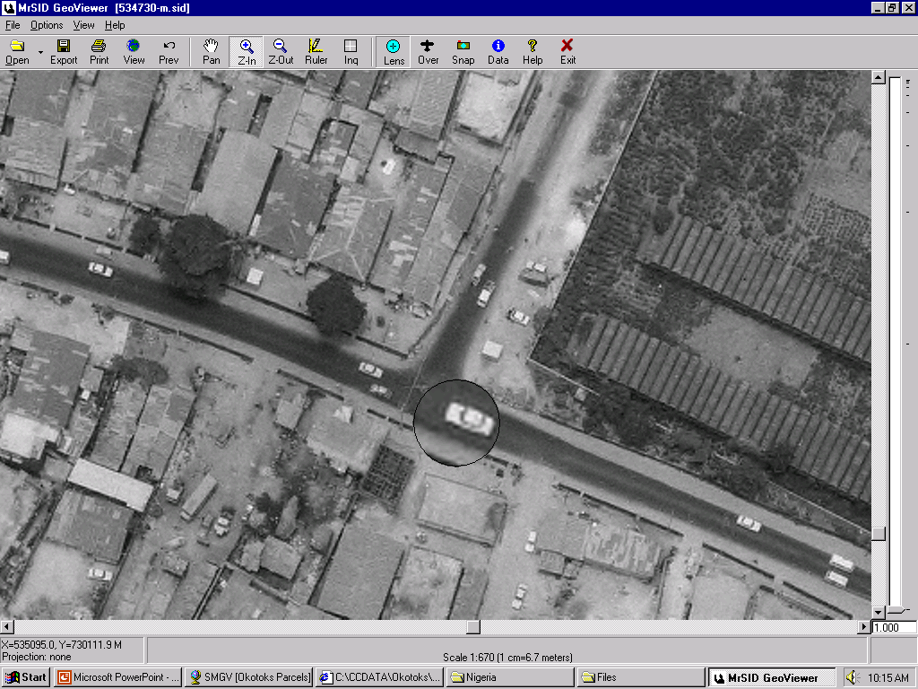
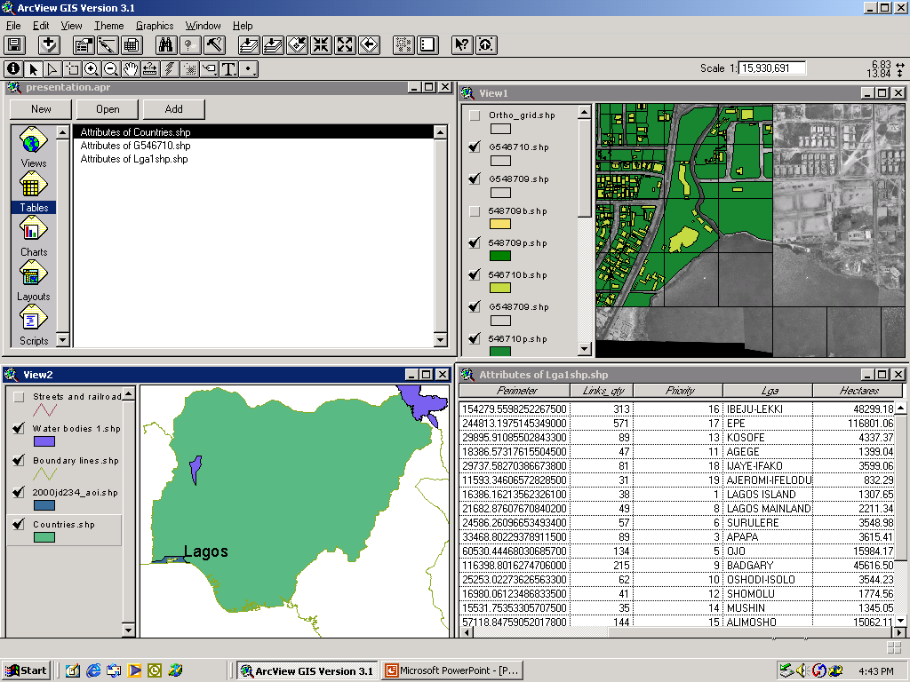
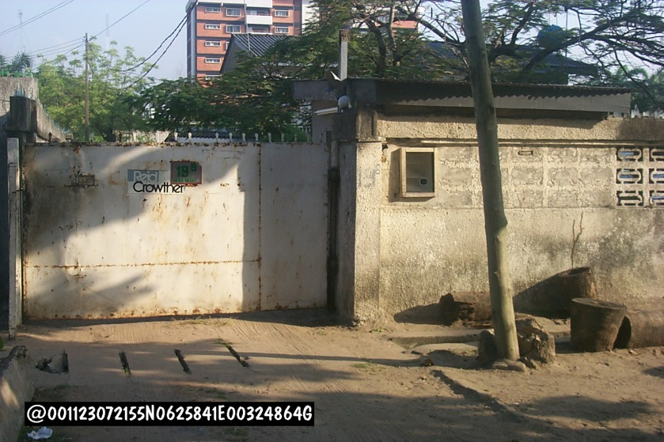
GIS in developing nations

Slide 5
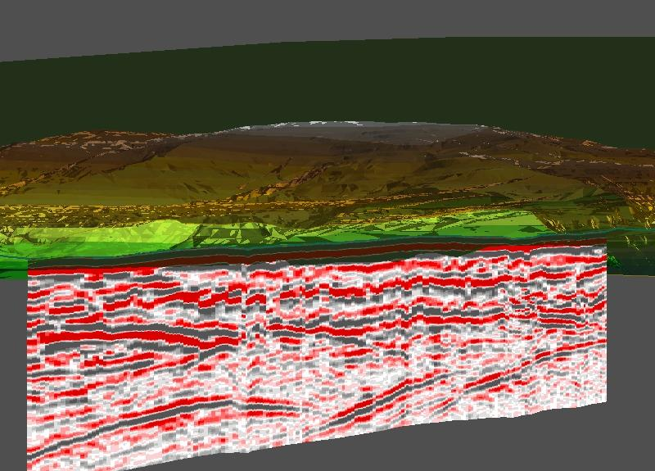
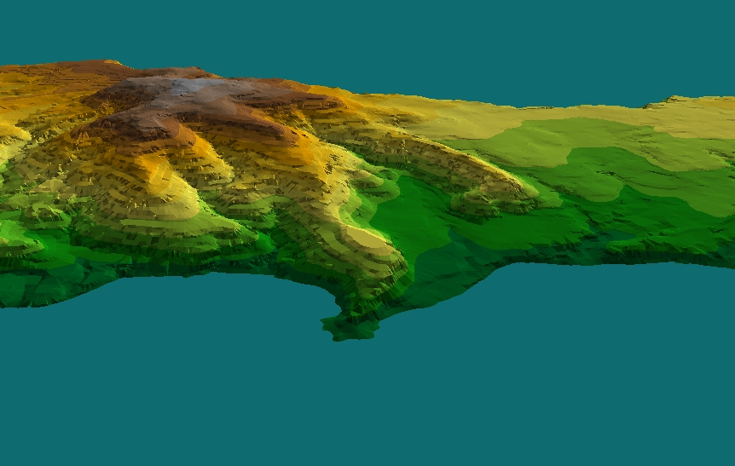
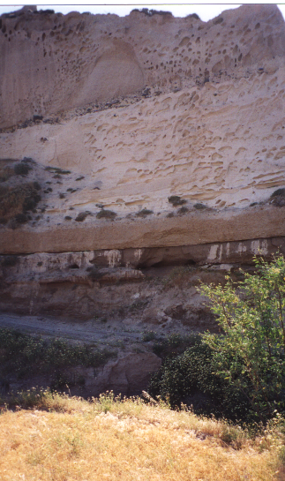
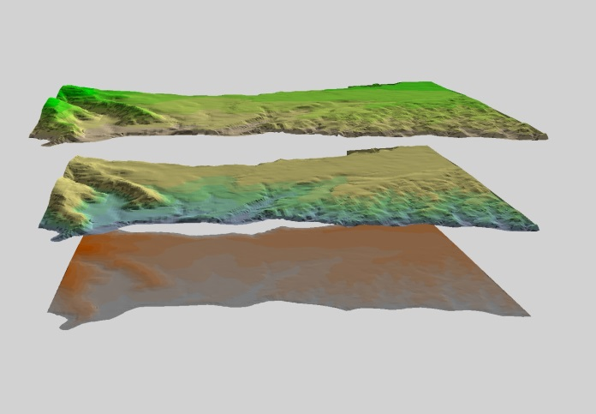
GPS/GPR and GIS in Archaeology

Slide 6
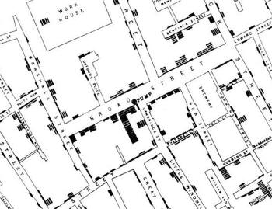


Strategic planning and decision making - History
John Snow's now famous cholera map. In 1854, people were dying in large numbers and high frequency, but nobody knew what was going on. John Snow solved the mystery with his map.

Slide 7
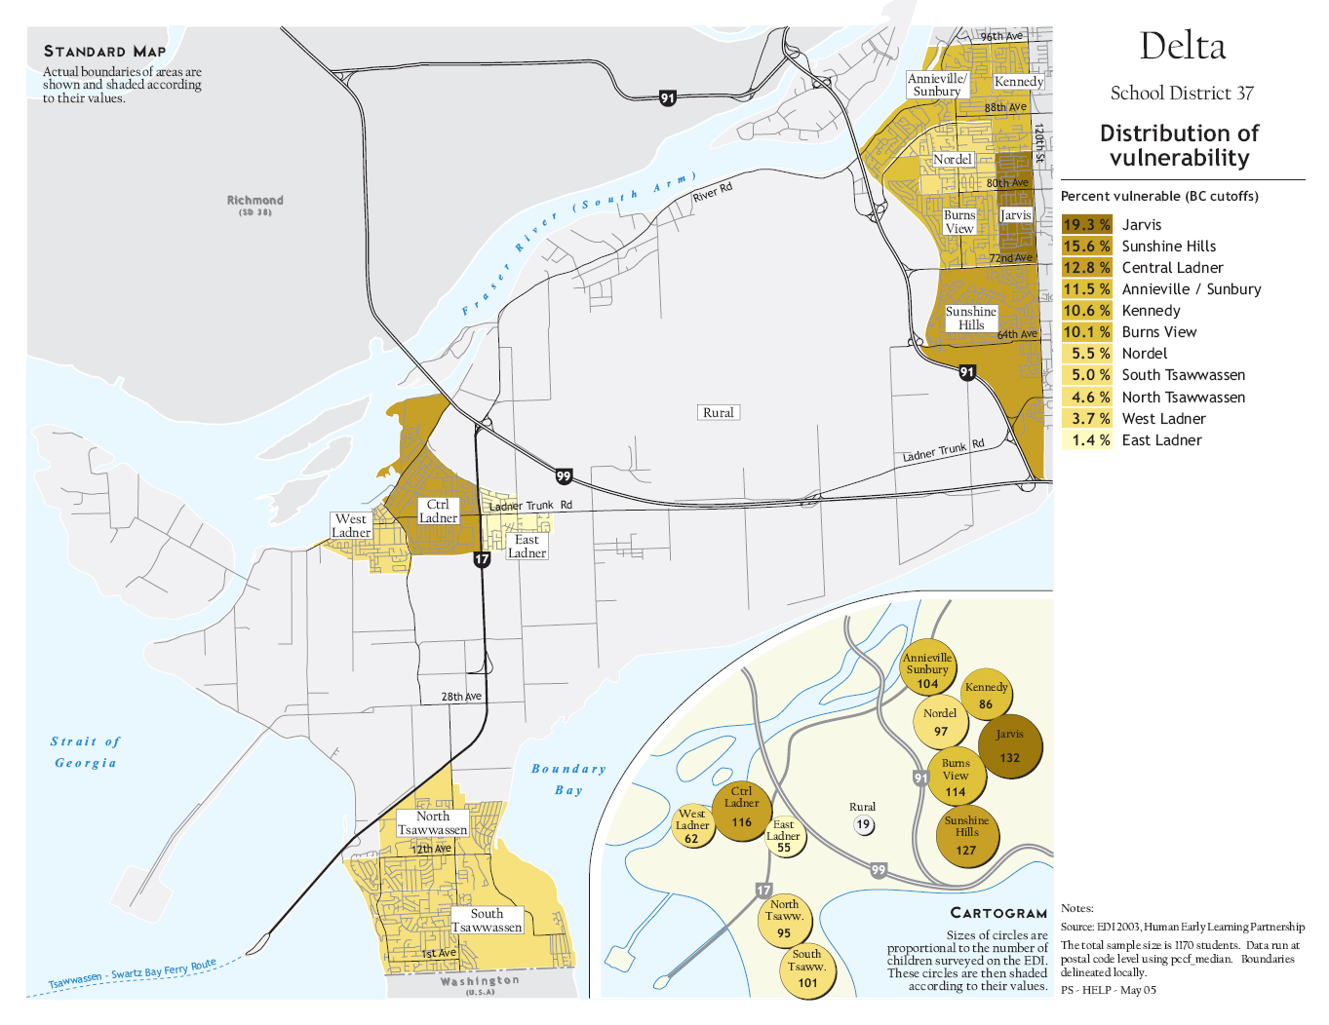
Health and Geography

Slide 8
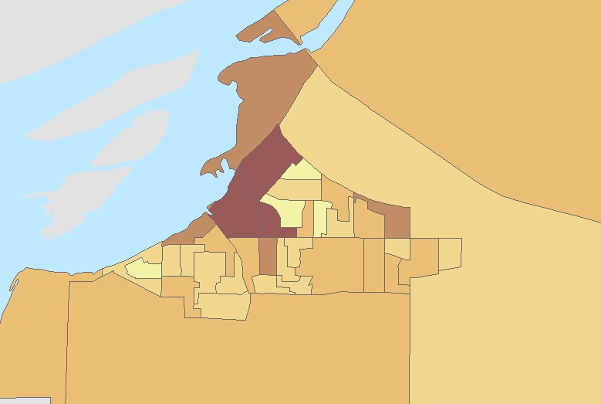
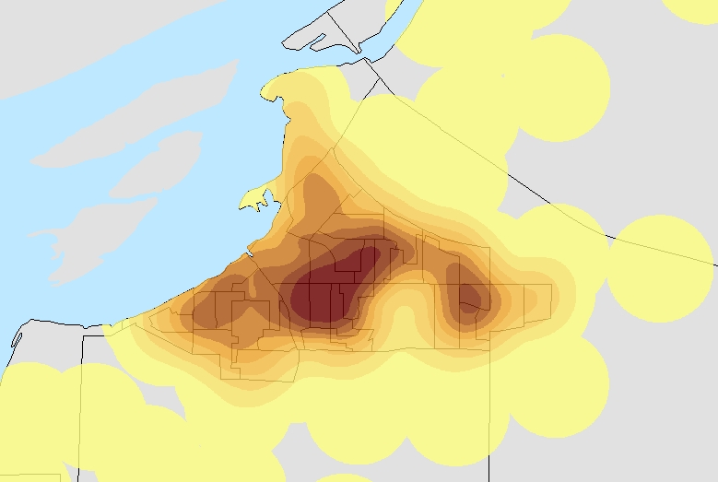
John Kirtland Wright (1891–1969)
Wright coined the term choropleth map in 1938, although the mapping technique itself was first used by Charles Dupin in 1826. Wright cautioned against the use of choropleth maps, instead espousing the virtues of the dasymetric map.
Choroplethic map
Dasymetric map
A comparison demonstrating choroplethic and dasymetric mapping techniques to show population distribution

Slide 9
Location theory
Is concerned with the geographic location of economic activity; it has become an integral part of economic geography, regional science, spatial economics and spatial epidemiology
Location theory addresses the questions of what economic activities are located where and why.
Location theory rests on the assumption that firms choose locations that maximize their profits and individuals choose locations that maximize their utility
It was not until the publication of Johann Heinrich von Thünen's first volume of Der Isolierte Staat in 1826 that location theory can be said to have really gotten underway.
Indeed, the prominent regional scientist Walter Isard has called von Thünen "the father of location theorists

Slide 10
Helping innovate healthcare
Creating interactive population healthcare applications for clients.
Utilizing an interdisciplinary approach between population health and retail analytics.
Using spatial data to determine and validate geographies of opportunities.

Slide 11
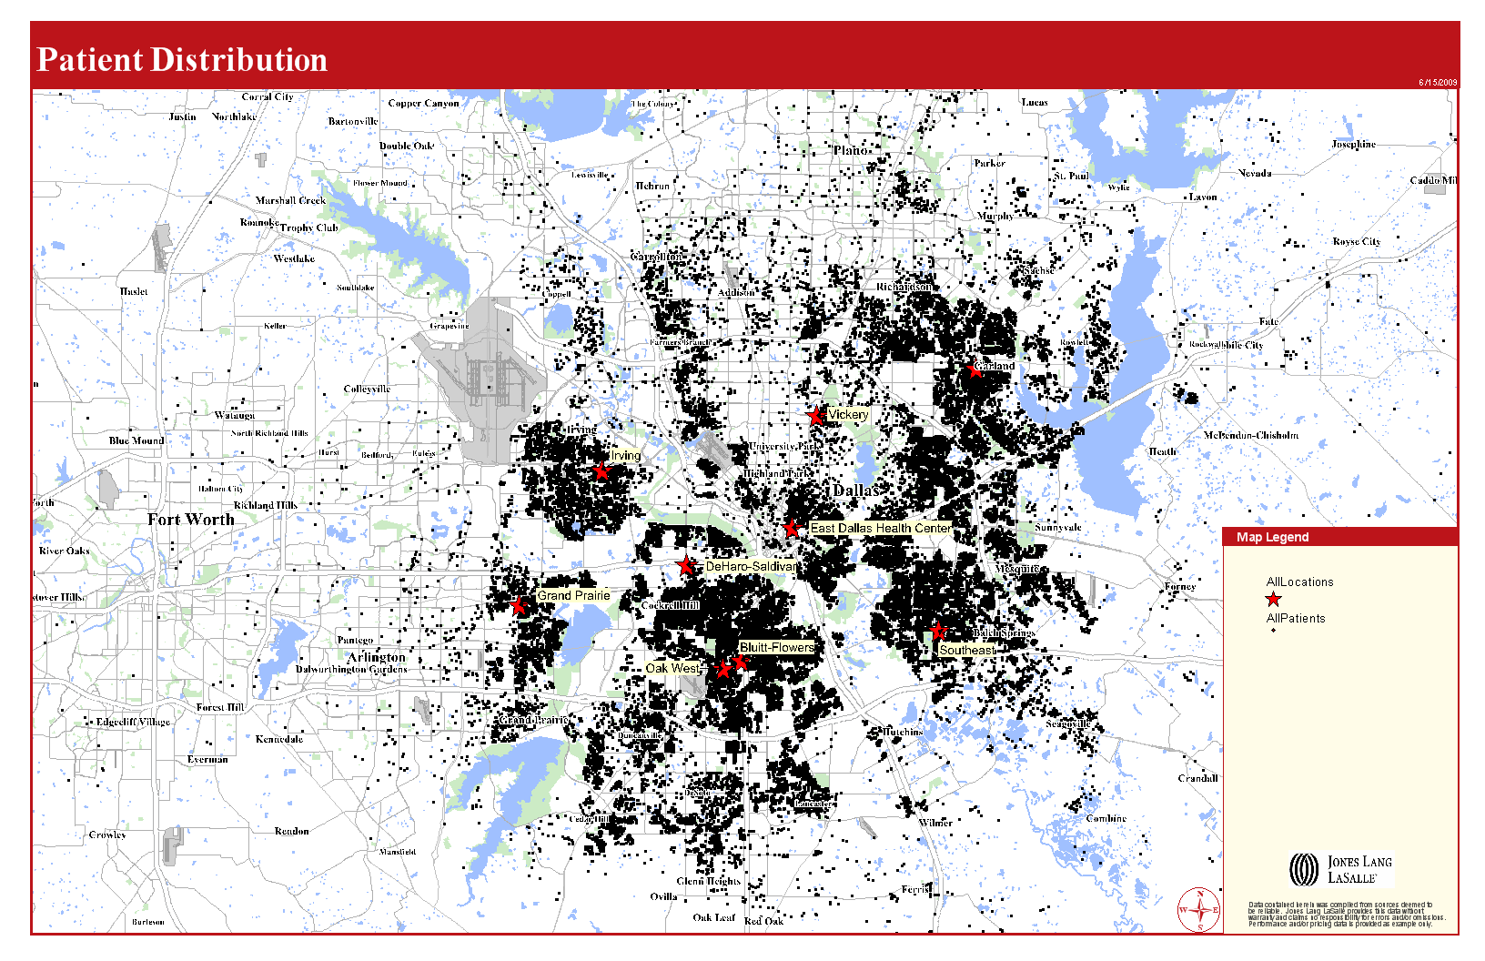

Slide 12
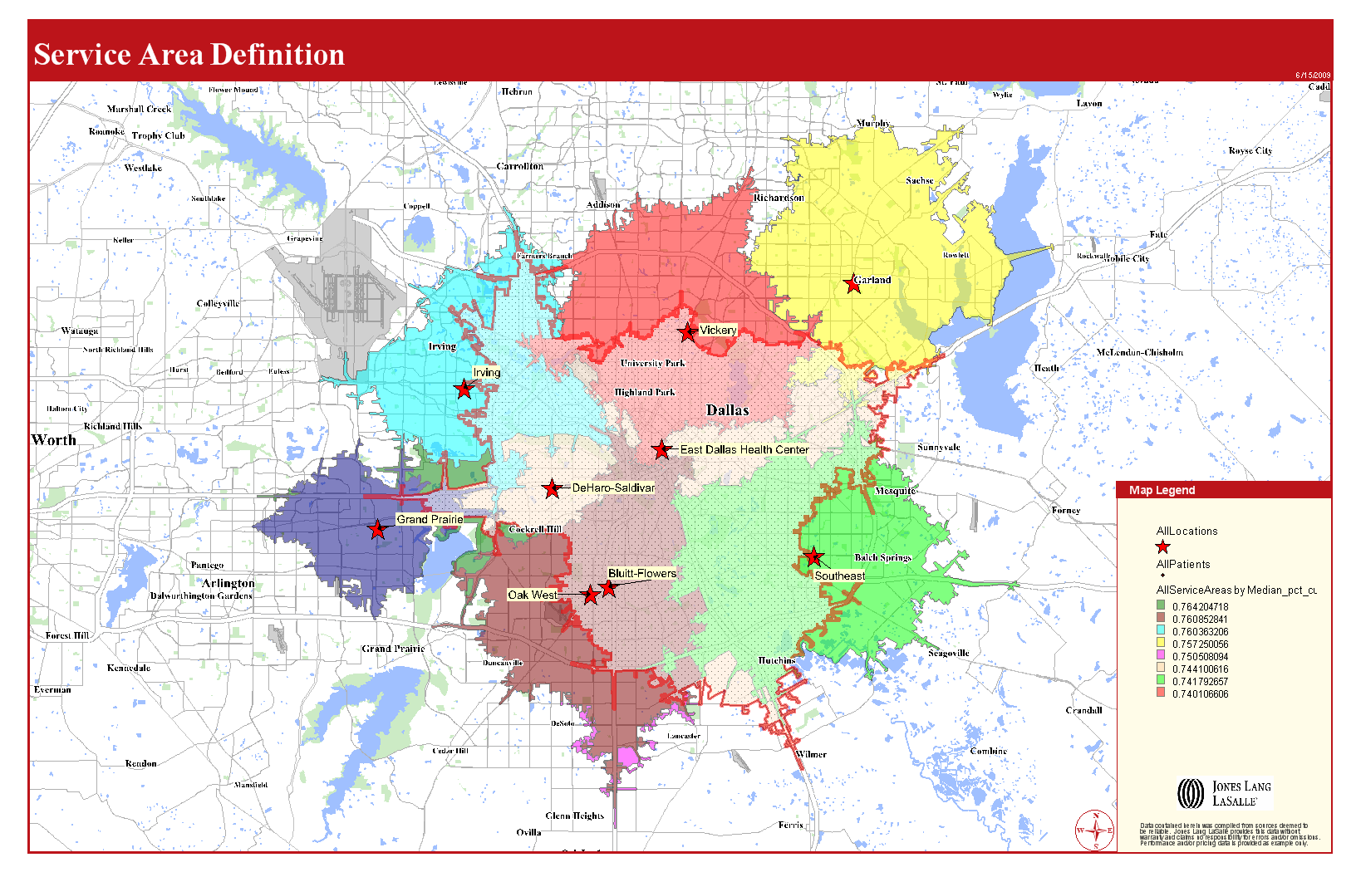
and cannibalization

Slide 13
 |  |  |  | Medical Expenditures
 |  |  |  |  | 1. Bluitt |  |  | ServiceAreas
 |  | Demographic Summary |  |  |  |  | 2011 |  |  | 2016
 |  | Population |  |  |  |  | 311,269 |  |  | 321,164
 |  | Households |  |  |  |  | 107,241 |  |  | 111,144
 |  | Families |  |  |  |  | 68,596 |  |  | 70,425
 |  | Median Household Income |  |  |  |  | $35,263 |  |  | $41,834
 |  | Males per 100 Females |  |  |  |  | 97.6 |  |  | 97.5
 |  | Population By Age
 |  | Population <5 Years |  |  |  |  | 8.1% |  |  | 8.2%
 |  | Population 65+ Years |  |  |  |  | 9.6% |  |  | 11.0%
 |  | Median Age |  |  |  |  | 32.1 |  |  | 32.5
 |  |  |  |  |  | Spending Potential | Average Amount
 |  |  |  |  |  | Index | Spent |  |  | Total
 |  | Health Care |  |  |  | 72 | $2,611.29 |  |  | $280,037,993
 |  | Medical Care |  |  |  | 73 | $1,262.79 |  |  | $135,423,461
 |  | Physician Services |  |  |  | 74 | $161.64 |  |  | $17,334,589
 |  | Dental Services |  |  |  | 69 | $216.86 |  |  | $23,255,763
 |  | Eyecare Services |  |  |  | 73 | $35.40 |  |  | $3,795,904
 |  | Lab Tests, X-Rays |  |  |  | 73 | $39.13 |  |  | $4,195,831
 |  | Hospital Room and Hospital Services |  |  |  | 79 | $105.37 |  |  | $11,300,514
 |  | Convalescent or Nursing Home Care |  |  |  | 61 | $13.75 |  |  | $1,474,751
 |  | Other Medical services (1) |  |  |  | 69 | $75.17 |  |  | $8,061,102
 |  | Nonprescription Drugs |  |  |  | 76 | $75.95 |  |  | $8,144,429
 |  | Prescription Drugs |  |  |  | 74 | $355.46 |  |  | $38,120,366
 |  | Nonprescription Vitamins |  |  |  | 75 | $41.44 |  |  | $4,444,010
 |  | Medicare Prescription Drug Premium |  |  |  | 74 | $35.55 |  |  | $3,812,390
 |  | Eyeglasses and Contact Lenses |  |  |  | 72 | $53.62 |  |  | $5,750,106
 |  | Hearing Aids |  |  |  | 58 | $12.27 |  |  | $1,315,412
 |  | Medical Equipment for General Use |  |  |  | 82 | $5.02 |  |  | $537,977
 |  | Other Medical Supplies (2) |  |  |  | 73 | $36.18 |  |  | $3,880,317
 |  | Health Insurance |  |  |  | 72 | $1,348.50 |  |  | $144,614,532
 |  | Blue Cross/Blue Shield |  |  |  | 70 | $380.98 |  |  | $40,856,322
 |  | Commercial Health Insurance |  |  |  | 73 | $263.54 |  |  | $28,262,379
 |  | Health Maintenance Organization |  |  |  | 74 | $239.62 |  |  | $25,696,783
 |  | Medicare Payments |  |  |  | 74 | $297.84 |  |  | $31,940,635
 |  | Long Term Care Insurance |  |  |  | 67 | $54.18 |  |  | $5,809,920
 |  | Other Health Insurance (3) |  |  |  | 69 | $112.35 |  |  | $12,048,493

Slide 14
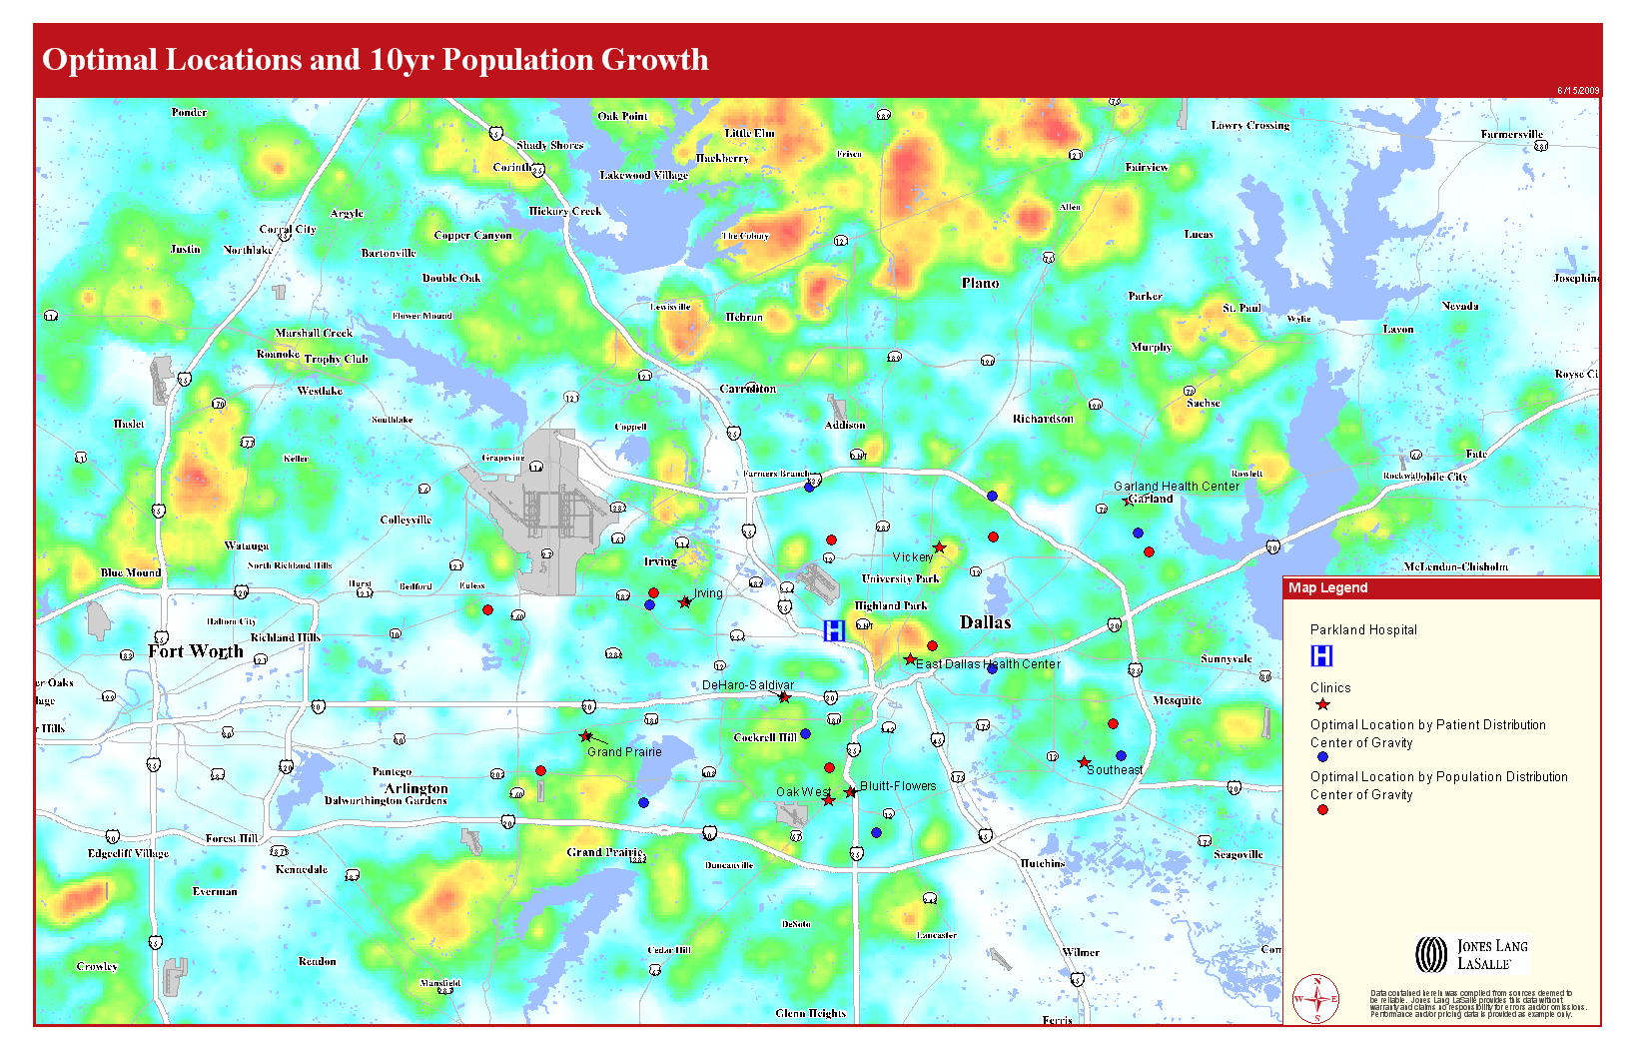

Slide 15
Pathology of determining a market for concussive injuries in sport
The American Journal of Medicine reports that 47.1 percent of concussive sports injuries between youths and adults are related to playing football
Concussive injuries are increasing by about 16% annually
Providing new medical services will require an understanding of where the impacted population clusters are located as well as understanding growth for sustainability of that service.
Jones Lang LaSalle proposes to build a multivariate model considering key demographic indicators as provided by The Brain Synergy Institute to select strategic markets to provide a brain rehabilitation service. Further, we propose adding population growth and playing football as two additional key indicators.
Once the top markets are selected, heat maps will be created with center of gravity analysis to place the service in a strategic location within market.

Slide 16
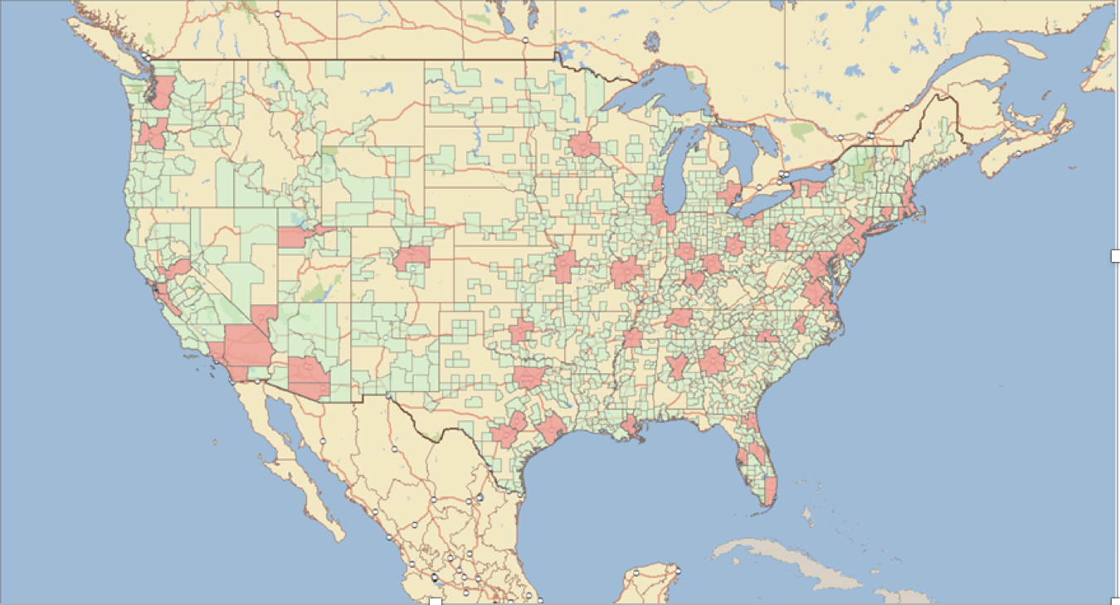
Multivariate modeling to select strategic markets
Map shows top 50 markets where population plays football which also establishes markets with a higher propensity for concussive injuries
Concussive injuries are increasing by about 16% annually
Cities with multiple professional sports teams - NFL, NHL, MLS, NBA
Income/wealth density
Collegiate sports
Plays Football
Population density
Population Growth
Proposed Model
The American Journal of Medicine reports that 47.1 percent of concussive sports injuries between youths and adults are related to playing football

Slide 17
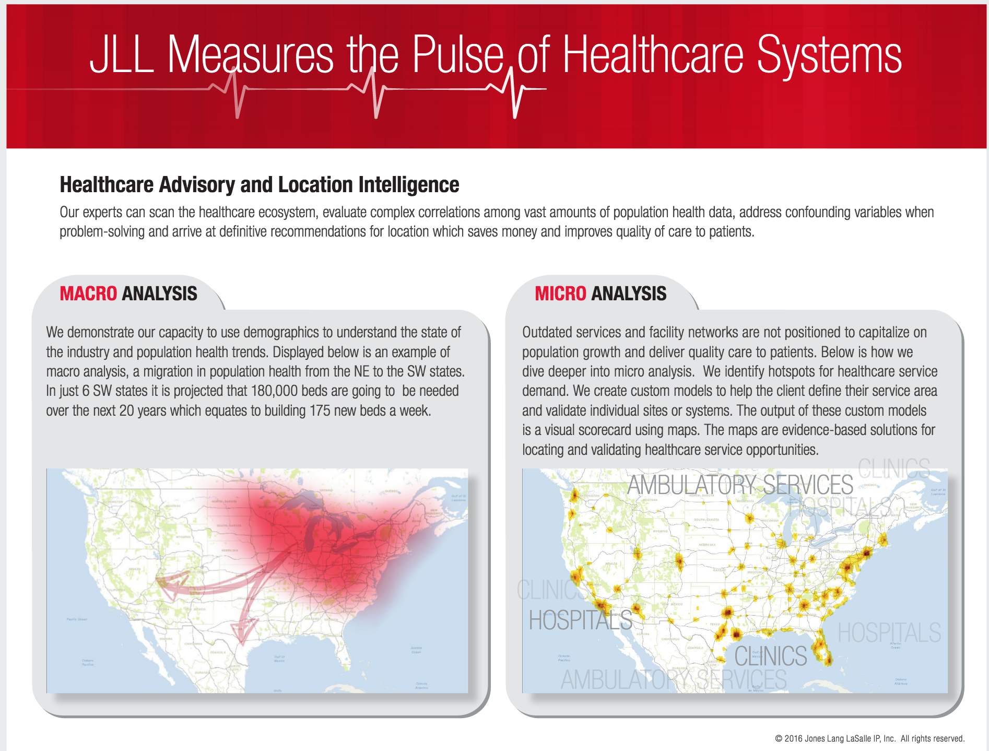

Slide 18

Social Science and Medicine
Soc Sci Med. 2010 Jan;70(2):277-92. doi: 10.1016/j.socscimed.2009.10.018. Epub 2009 Oct 31.
Examining methodological details of neighbourhood observations and the relationship to health: a literature review.
Schaefer-McDaniel N¹, Caughy MO, O'Campo P, Gearey W.
Abstract
Neighbourhood research has been growing steadily over the past two decades across the social sciences, and, in particular in the area of public health. Despite this increase, there is currently no consensus on which measure and data source researchers should use to assess neighbourhood attributes. In the past, researchers have relied on census data and household surveys to assess neighbourhood conditions, but in recent years, neighbourhood observations have become a popular alternative method for characterizing neighbourhood environments. Rooted in sociology of crime research, observations are conducted by trained observers who use a checklist to observe and rate neighbourhoods on a number of conditions such as physical (e.g., traffic volume, housing conditions) and social (e.g., presence of people, gang activity) attributes. While this methodology has been gaining momentum in recent years, notably absent from the literature is a review to examine this methodology in detail. The purpose of the present study was to examine research that has used neighbourhood observations as a method. We do so by critically reviewing 51 English language studies published from 1990 onward paying particular attention to the areas of (1) methodological rigor (i.e. how observations are carried out in the field and how data are analyzed), (2) geographical boundaries (i.e. how neighbourhoods and areas of observation are spatially defined), and (3) the relationship between neighbourhood observations and residents' health (i.e. how studies examine and analyze the link between observed neighbourhood attributes and health). We find that little attention is given to details of neighbourhood observations as a method. Further, there is wide variability in how observations are conducted and analyzed making it impossible to confidently compare findings across studies. We see this review as a first step in developing sound observational measures of neighbourhood factors and conclude by providing recommendations for researchers undertaking neighbourhood observations in the future.

Slide 19
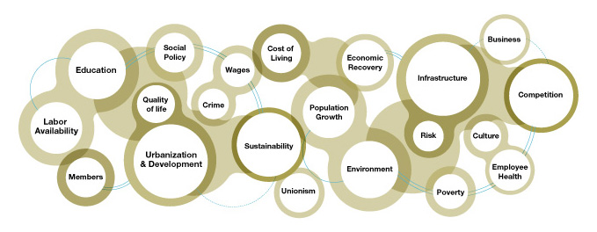
Identifying a geography of opportunity within the business ecosystem
Not one size fits all modeling different key variables are important to different companies

Slide 20
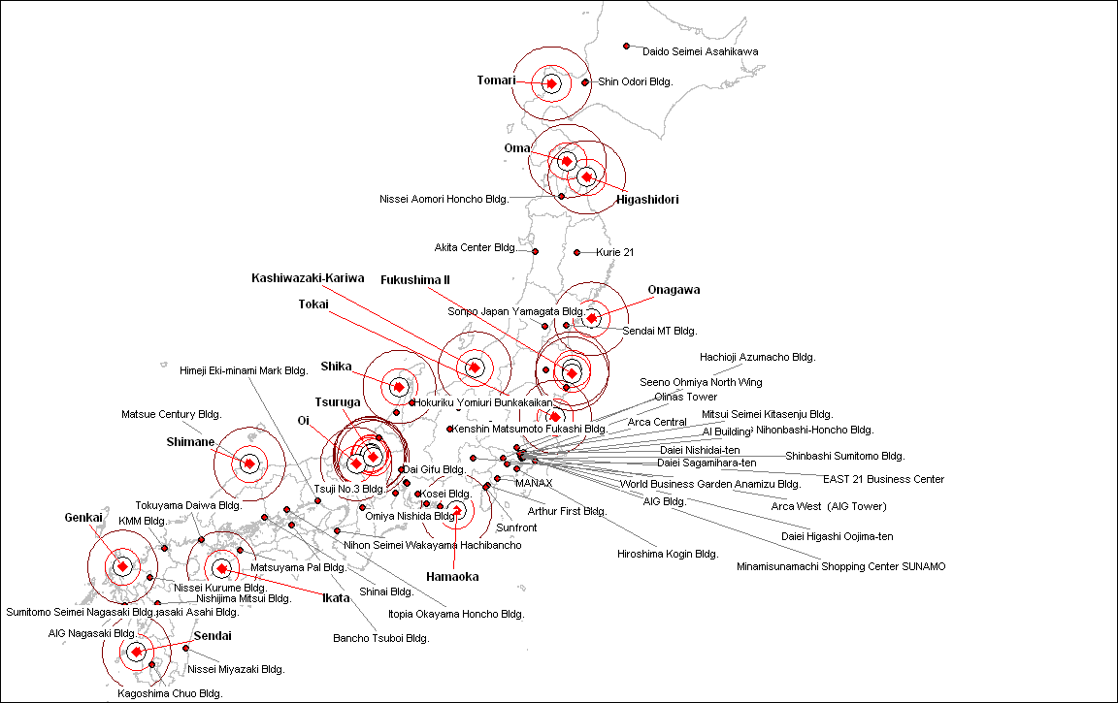
Disaster planning: MetLife – Japan Tsunami
309 Billion in damage
Number of Metlife buildings at risk within a 50 mile radius of a nuclear reactor
Nuclear Power Plant | Number of Offices
Fugen: 50.0 Miles | 2
Fukushima II: 50.0 Miles | 4
Genkai: 50.0 Miles | 1
Hamaoka: 50.0 Miles | 3
Higashidori: 50.0 Miles | 1
Ikata: 50.0 Miles | 2
Mihama: 50.0 Miles | 3
Monju: 50.0 Miles | 2
Oi: 50.0 Miles | 2
Oma: 50.0 Miles | 1
Onagawa: 50.0 Miles | 1
Sendai: 50.0 Miles | 1
Shika: 50.0 Miles | 3
Shimane: 50.0 Miles | 1
Tokai: 50.0 Miles | 1
Tomari: 50.0 Miles | 2
Tsuruga: 50.0 Miles | 3
Initially we were able to verify which buildings were destroyed by the tsunami. We were then asked to assess the risk associated with proximity to nuclear power plants

Slide 21
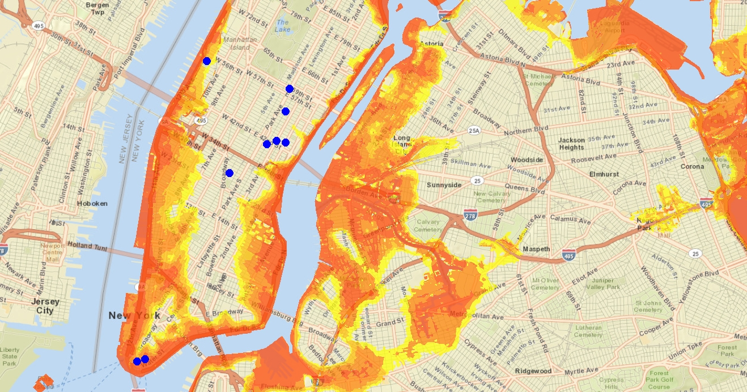
Disaster Planning– JLL Hurricane Sandy $50 Billion
A model was created to forecast which buildings managed by JLL would be at risk
21

Slide 22
Colorado Springs: Current talent location assessment
Saturation
Outlook
Employment growth in the Colorado Springs metro area will average 2.0% annually between 2013 and 2017, slightly above the national average. Professional and business services will experience a rebound in job growth, at 4.5% per year on average
Calculated Workforce | Estimated Workforce in Call Center/ Back Office Operation | Calculated Saturation (% of entire workforce employed in call center or back office operation)
362,847 | 15,375 | 4.24%
In spite of the high rate of saturation this market is strong workforce growth predicted to be well above the national mean. Based on the call center workforce potential of 64,381 and 19.25% growth in the overall workforce, 300 new call center workers will be available this year creating sustainability and opportunity for Comcast in this market.
Average mean salary for call center representative general calls - $27,646
Issues to watch
The looming budget sequester, which is heavily weighted toward defense cuts, poses major downside risk to the area economy because of the importance of Fort Carson. While we still assume that the budget sequester will be of short duration if it takes effect, the risk is increasing. Thousands of defense workers, both military and civilian, would at least see reductions in days worked.
Market | Labor Availability | Workforce sustainability | Cost of Labor | Educational Attainment | Cost of Living | Quality of Life | Market Score | Wage Volatility | State Income Tax Rate | Colleges and Universities | Colleges and Universities - Total Enrollment | Absolute Growth 10Yr | Tech Savvy Workforce
Colorado Springs, CO | 114 | 138 | 91 | 158 | 98 | 112 | 117 | 0.09 | 4.63 | 18 | 60779 | 126795 | 189
1. An index value of 100 represents an average using the US as a geographic base.
2. Index Scale Red: 0 – 90 (RISK) Yellow: 91 - 119 (Neutral) Green: 120+ (opportunity)

Slide 23
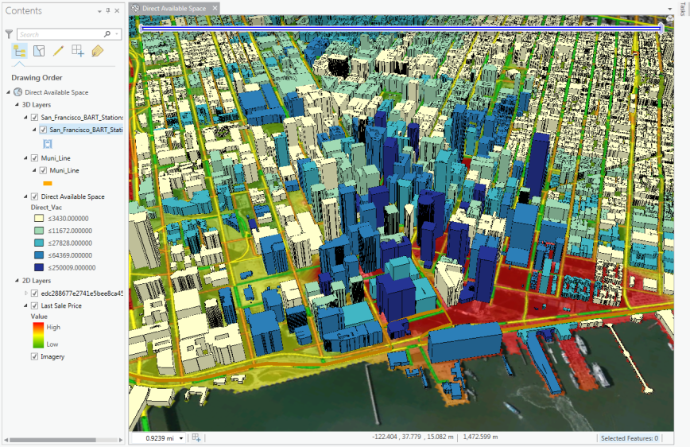
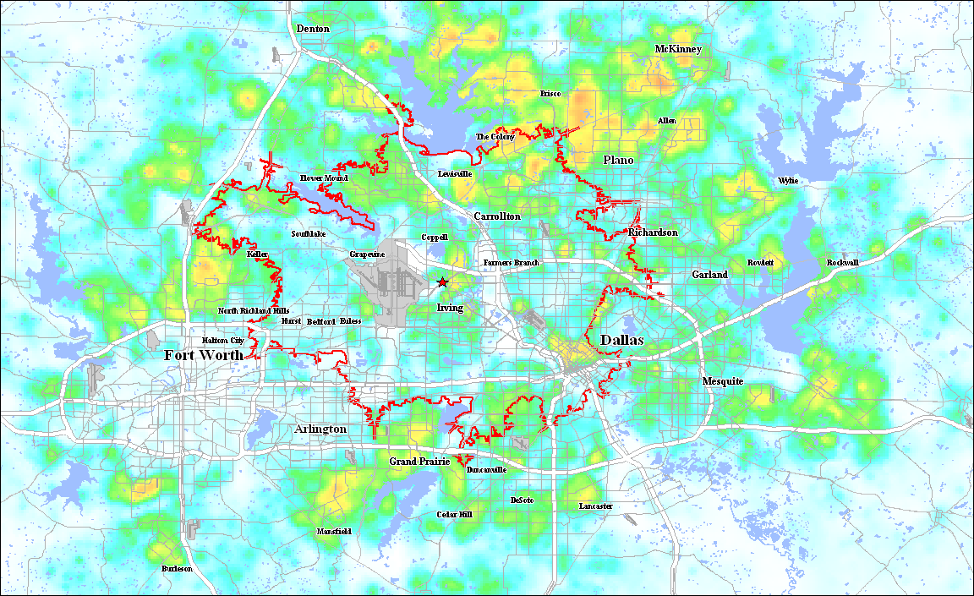
Analytics
 |  |  | Talent 40% |  |  |  |  | Cost of doing Business 40% |  |  |  | Corporate Culture 20%
Rank | CBSA | State | Labor Availability | Educational Attainment | Workforce Sustainability | Tech Savvy Workforce | Talent Index | Cost of Labor | Cost of Living | Tax Environment | Cost Index | Legal Environment | Quality of Life | Corporate Culture Index | Location Index | Location Index2
1 | Boulder/Denver | CO | 131 | 181 | 134 | 191 | 159 | 85 | 84 | 116 | 95 | 99 | 113 | 106 | 154 | 123
2 | Olympia | WA | 168 | 143 | 146 | 124 | 145 | 91 | 88 | 148 | 109 | 92 | 100 | 96 | 139 | 121
3 | Salt Lake City/ Ogden | UT | 127 | 124 | 149 | 116 | 129 | 102 | 101 | 131 | 111 | 121 | 99 | 110 | 126 | 118
4 | Bremerton-Silverdale | WA | 93 | 139 | 143 | 149 | 131 | 102 | 89 | 148 | 113 | 92 | 108 | 100 | 128 | 118
5 | Bellingham | WA | 150 | 124 | 132 | 96 | 126 | 102 | 83 | 148 | 111 | 92 | 118 | 105 | 122 | 116
6 | Spokane | WA | 146 | 128 | 114 | 90 | 120 | 98 | 100 | 148 | 115 | 92 | 108 | 100 | 118 | 114
7 | Las Vegas | NV | 75 | 88 | 150 | 80 | 98 | 96 | 91 | 150 | 112 | 137 | 85 | 111 | 97 | 106
8 | Seattle-Tacoma-Bellevue | WA | 116 | 140 | 106 | 82 | 111 | 85 | 70 | 148 | 101 | 92 | 110 | 101 | 111 | 105
9 | Phoenix | AZ | 125 | 93 | 107 | 129 | 114 | 93 | 93 | 96 | 94 | 96 | 110 | 103 | 109 | 104
10 | Kennewick-Richland-Pasco | WA | 88 | 97 | 106 | 105 | 99 | 94 | 93 | 148 | 112 | 92 | 98 | 95 | 98 | 103
11 | Medford | OR | 118 | 108 | 119 | 82 | 107 | 113 | 116 | 94 | 108 | 89 | 79 | 84 | 108 | 103
12 | Portland-Vancouver-Beaverton | OR-WA | 154 | 121 | 120 | 91 | 121 | 91 | 78 | 94 | 88 | 89 | 95 | 92 | 118 | 102
13 | Eugene-Springfield | OR | 130 | 134 | 104 | 94 | 115 | 91 | 99 | 94 | 95 | 89 | 87 | 88 | 115 | 102
14 | Salem | OR | 118 | 89 | 128 | 91 | 106 | 99 | 103 | 94 | 99 | 89 | 84 | 87 | 104 | 99
15 | San Jose-Sunnyvale-Santa Clara | CA | 134 | 144 | 94 | 210 | 146 | 67 | 58 | 38 | 55 | 73 | 101 | 87 | 137 | 97
16 | Sacramento--Arden-Arcade--Roseville | CA | 150 | 113 | 121 | 146 | 133 | 81 | 79 | 38 | 66 | 73 | 101 | 87 | 125 | 97
17 | San Diego-Carlsbad-San Marcos | CA | 148 | 120 | 111 | 150 | 132 | 82 | 66 | 38 | 62 | 73 | 102 | 88 | 125 | 95
18 | Yakima | WA | 68 | 71 | 113 | 38 | 73 | 102 | 96 | 148 | 115 | 92 | 86 | 89 | 75 | 93
19 | Oxnard-Thousand Oaks-Ventura | CA | 126 | 103 | 107 | 154 | 122 | 82 | 72 | 38 | 64 | 73 | 105 | 89 | 116 | 92
20 | Santa Cruz-Watsonville | CA | 68 | 131 | 86 | 187 | 118 | 76 | 65 | 38 | 60 | 73 | 104 | 89 | 115 | 89
21 | San Luis Obispo-Paso Robles | CA | 68 | 116 | 93 | 112 | 97 | 95 | 87 | 38 | 73 | 73 | 113 | 93 | 99 | 87
22 | Santa Barbara-Santa Maria | CA | 96 | 115 | 80 | 141 | 108 | 92 | 68 | 38 | 66 | 73 | 98 | 86 | 106 | 87
23 | Riverside-San Bernardino-Ontario | CA | 90 | 71 | 165 | 70 | 99 | 88 | 88 | 38 | 71 | 73 | 110 | 92 | 95 | 86
24 | *San Francisco-Oakland-Fremont | CA | 64 | 143 | 88 | 206 | 125 | 71 | 41 | 38 | 50 | 73 | 86 | 80 | 120 | 86
25 | Santa Rosa-Petaluma | CA | 82 | 112 | 99 | 125 | 105 | 79 | 75 | 38 | 64 | 73 | 106 | 90 | 103 | 85
26 | Fresno | CA | 122 | 74 | 153 | 53 | 100 | 82 | 87 | 38 | 69 | 73 | 101 | 87 | 96 | 85
27 | Stockton | CA | 96 | 65 | 189 | 66 | 104 | 76 | 83 | 38 | 66 | 73 | 96 | 85 | 98 | 85
28 | Los Angeles-Long Beach-Santa Ana | CA | 104 | 95 | 86 | 133 | 105 | 82 | 55 | 38 | 58 | 73 | 108 | 91 | 100 | 83
29 | Bakersfield | CA | 46 | 62 | 165 | 68 | 85 | 93 | 94 | 38 | 75 | 73 | 113 | 93 | 84 | 83
30 | Visalia-Porterville | CA | 82 | 55 | 180 | 35 | 88 | 97 | 104 | 38 | 80 | 73 | 82 | 78 | 86 | 83

Slide 24

2013 data evolution is underway in business
Apple’s Acquisition of Locationary Means for Smart Services - July 2013
Apple had acquired local data company Locationary.
The Toronto-based Locationary, a small Canadian startup backed by Extreme Venture Partners and Plazacorp Ventures, is a Wikipedia of sorts for location data. It’s obvious what Apple’s plans are with Locationary: beef up its new mapping service.
Maponics purchased by Pitney Bowes.
WHO has the location based data?
Questions?

Slide 25

Why Uber is buying map companies
In July 2015, Uber acquired a significant chunk of Microsoft Bing’s mapping assets. This included about 100 employees and guesstimates of licensed intellectual property from the Redmond, Washington giant.
In March, Uber’s first mapping acquisition was San Jose-based deCarta. It paid an undisclosed sum for the company that helped power GM’s OnStar turn-by-turn navigation system.
UBER now a location company
Minutes and seconds can generate millions of dollars

Slide 26
Large Consulting practices: The Big 4 – Deloitte, PwC, Ernst and Young, KPMG
This interest is reflected in the fact that spatial visualization is one of Deloitte's top 10 technology priorities of 2012. This new segment is being called location analytics and is focused on thematic mapping and spatial analysis for the world of business analytics

Slide 27
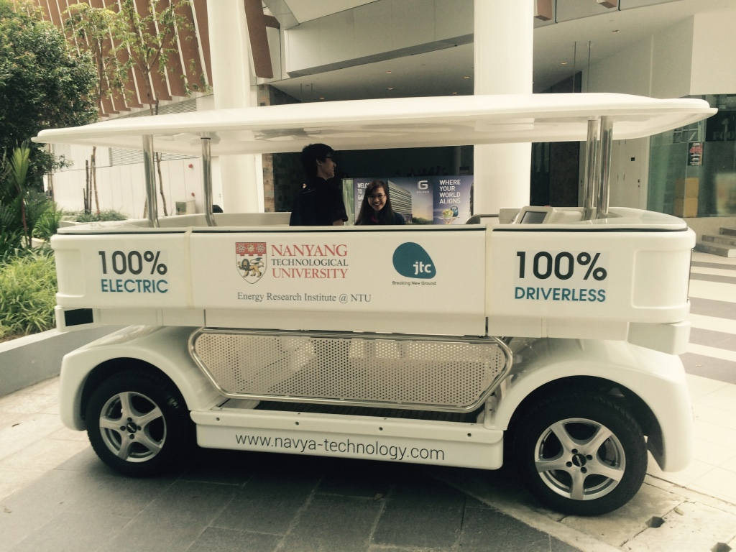
Location Analytics Market to grow from USD 7.2 Billion in 2015 to USD 14.2 Billion in 2020, at a Compound Annual Growth Rate (CAGR) of 14.5%

Slide 28
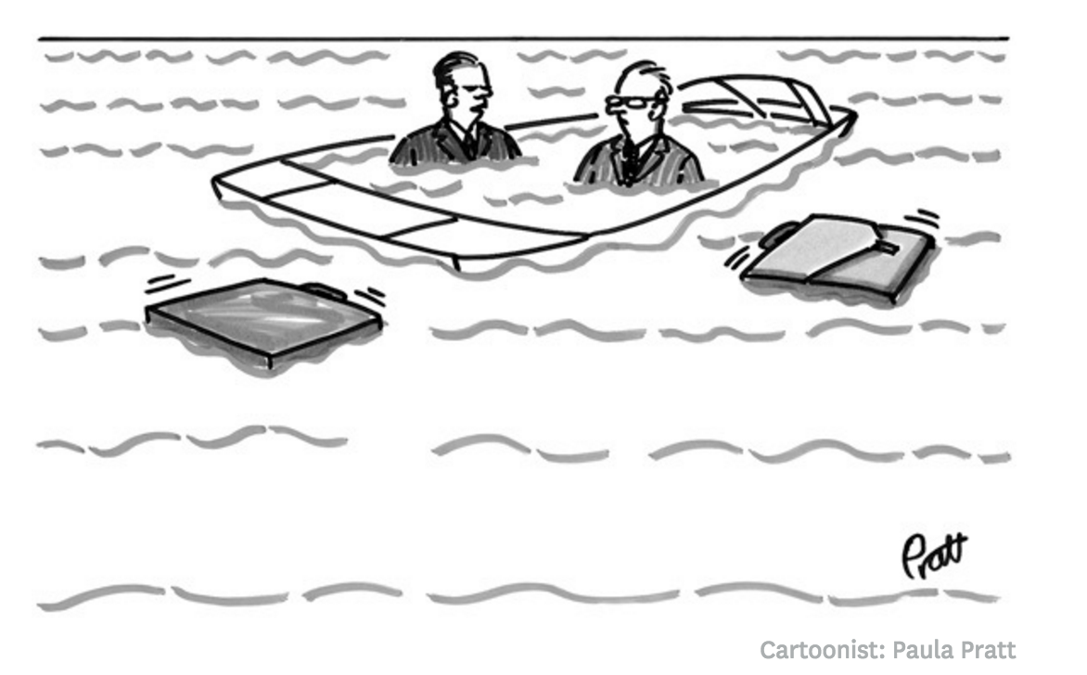
Enterprise GIS for real estate
Once managers have assessed their company’s situation and adopted a more robust framework for considering real estate decisions, the next step is to assemble the people, data and technology they need for detailed analysis.
“the whole technology thing its kind of complicated”

Slide 29
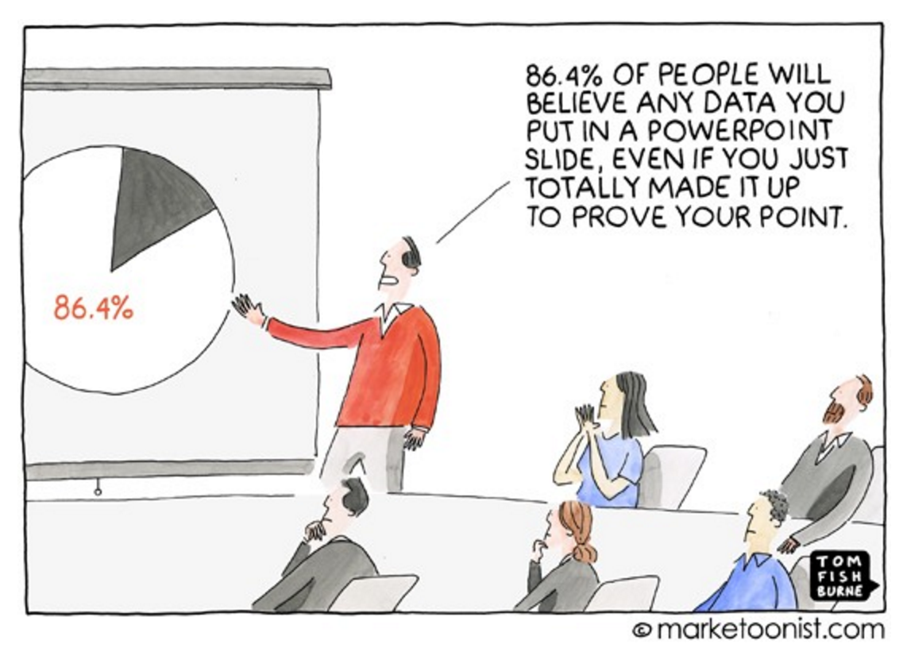
Executives and managers, clients are being bombarded with dashboards brimming with analytics.
They struggle with data-driven decision making because they don’t know the story behind the data.

Slide 30

Overcoming Technology Challenges
Redundant investments in data across the LOB or regions
Not hosted in the cloud for mobile access- anytime, anywhere
Bad user experiences by having to use multiple tools for one pitch
Lack of dynamic capabilities to move from macro to micro view of data
Data and
ANALYTICS
Tools are not connected or shared across LOB or regions
No automated reports or self-service tools for multi-market comparisons

Slide 31
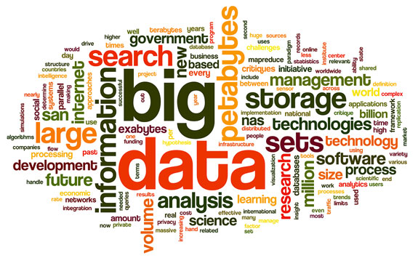
Sparked A Conversation
Research shows digital readiness is key

Slide 32
4 Essential goals
Identifying analytical tools and structures for the enterprise (MapIT platform)
Creating a culture of analytics that’s built on reproducible processes
Making data accessible so that people can innovate
Measuring how analytics is changing the business

Slide 33
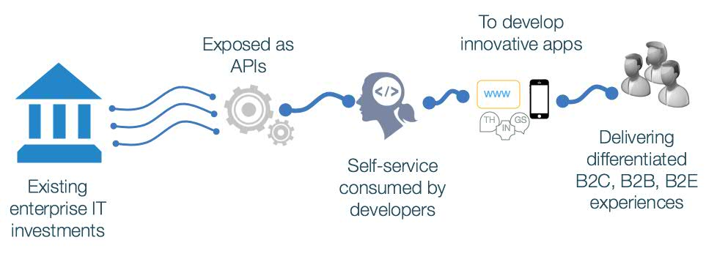
+ API Economy

Slide 34
Achieving Corporate Global Location Intelligence

Slide 35
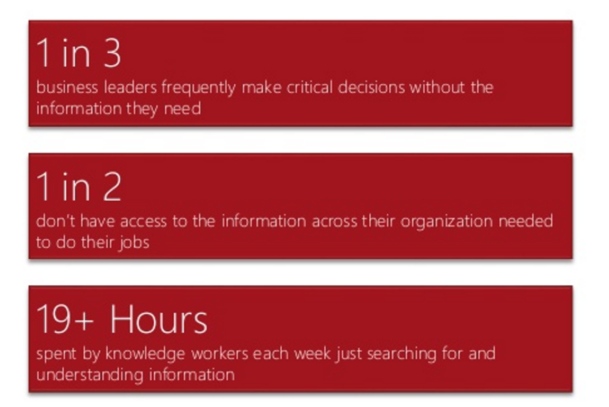
Data science for decision support
Location intelligence is the process for selecting the optimal location that will support workplace success and address a variety of business and financial objectives.
Study to support investment in IT, data and analytics

Slide 36
What is data science?
Those strong in statistics: they sometimes develop new statistical theories for big data, that even traditional statisticians are not aware of. They are expert in statistical modeling, experimental design, sampling, clustering, data reduction, confidence intervals, testing, modeling, predictive modeling and other related techniques.
Those strong in mathematics: research people doing analytic business optimization (inventory management and forecasting, pricing optimization, supply chain, quality control, yield optimization) as they collect, analyse and extract value out of data.
Those strong in data engineering, Hadoop, database/memory/file systems optimization and architecture, API's, Analytics as a Service, optimization of data flows, data plumbing.
Those strong in machine learning / computer science (algorithms, computational complexity)
Those strong in business, ROI optimization, decision sciences, involved in some of the tasks traditionally performed by business analysts in bigger companies (dashboards design, metric mix selection and metric definitions, ROI optimization, high-level database design)
Those strong in production code development, software engineering (they know a few programming languages)
Those strong in visualization
Those strong in GIS, spatial data, data modeled by graphs, graph databases
Those strong in Social Science

Slide 37
An enterprise model
Embedding GIS/ BI and data science are part of building a proprietary, competitive and interactive self service CRE technology platform for the firm
Integrating and
synthesizing information
from many sources
Breaking down silos
and information gaps
for every level of user
Facilitating
communication
and collaboration
Clients want an interactive platform to review analytics and make location decisions

Slide 38
Who are the users, super-users and enablers? Self Support
From Global to Local; key enablers and business alignment
Global
IT
Location Intelligence
Pan EMEA
Data
Local
Clients
Business Teams
Marketing

Slide 39
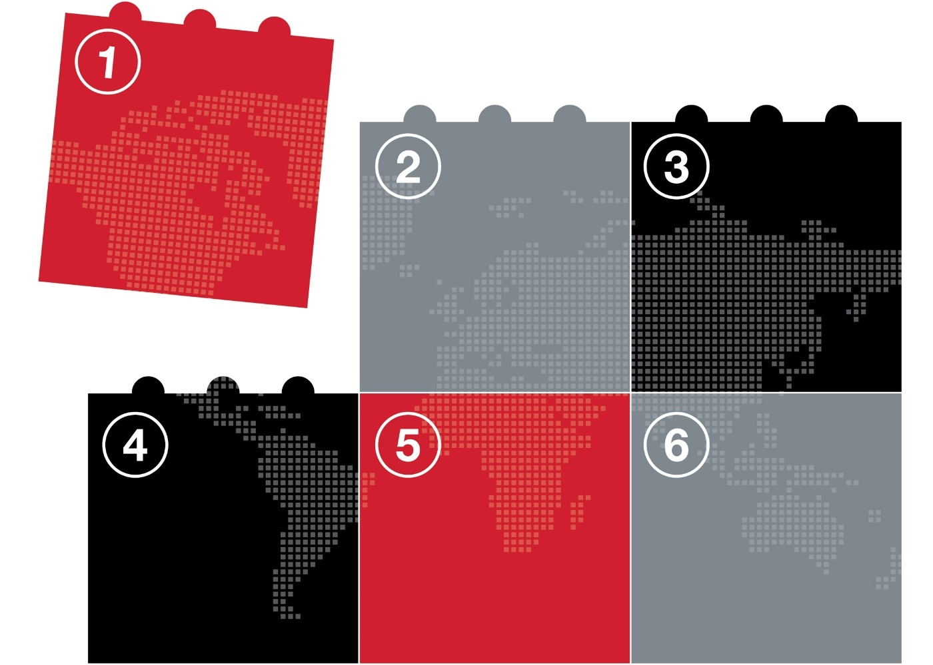
Creating a Connected Platform
Our clients want and expect a connected digital experience
Strategy and
Innovation
Focus on business and IT collaboration creating innovative client solutions
Process
Automation
Line of Business
Understanding the business process and the user experience
Reinvented processes and customer journeys through automation and agile processes
Organization
Technology
Data and
Analytics
Agile, flexible,
and collaborative processes and capabilities that improve operational efficiencies
Usable and relevant customer analytics tied to goals and strategies for real estate solutions
2-speed IT to support core functions and rapid development

Slide 40


Client Confidence Accelerators – creating a culture
Increased productivity and responsiveness developed for greater client value
Data
Thousands of variables across 140 countries
and growing
Technology
One access point
for all data and technology needs
Speed
Self-service tools, templates and applications for intelligent client solutions
Collaboration
Connected to LOB, online library of solutions. Client access portal

Slide 41

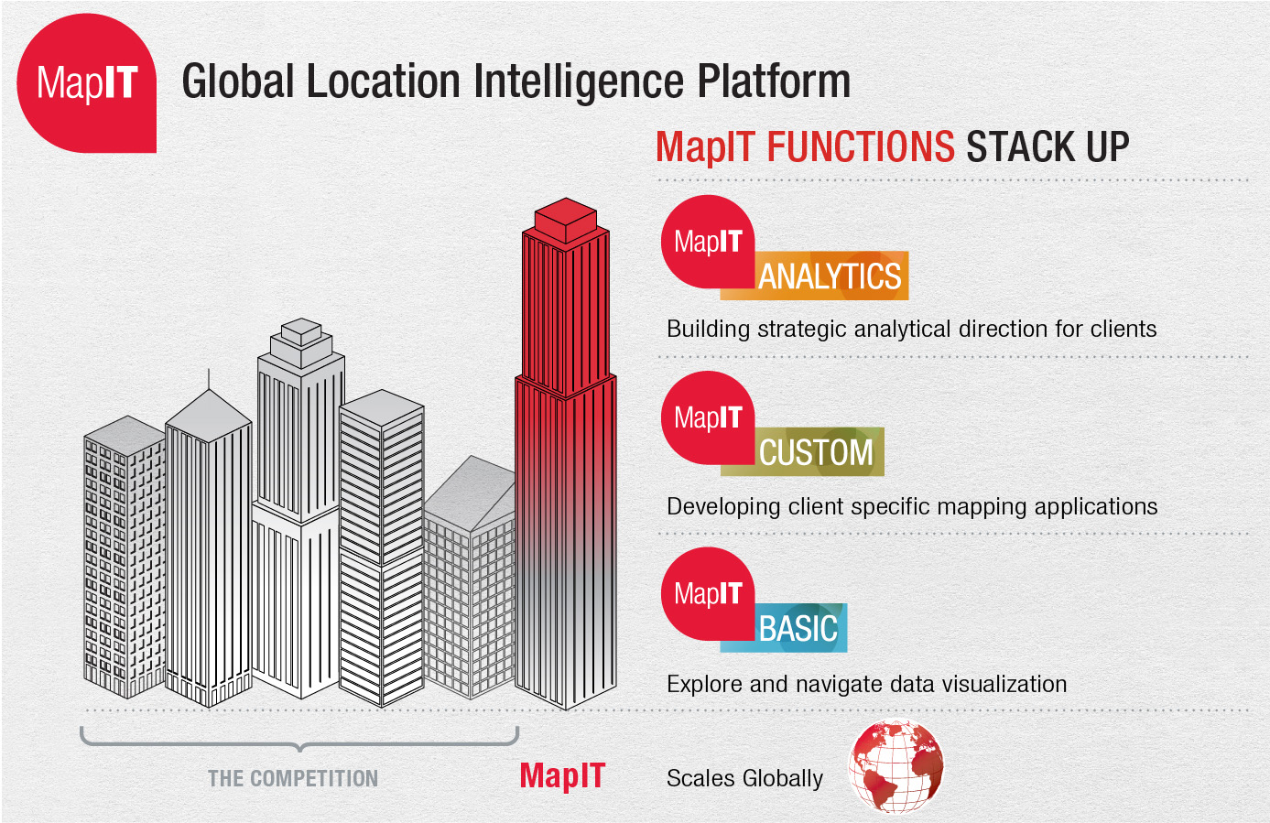

Slide 42



Three Service Levels of MapIT
Basic
Expansive data sources from JLL platforms, third party providers and the web.
Create a map that can be viewed in a browser, desktop or mobile device. Share
it via email, or embed it
in a website
Advanced
Build a unique solution and interactive application for your client
Demonstrate market awareness of one or more global markets
Easy to use presentation templates for pitches and fast application generators
Custom
Custom application models to win more business
Client focused applications for self service access to
JLL modeling.
Custom productivity tools
to accelerate content development for marketing and pitching business

Slide 43
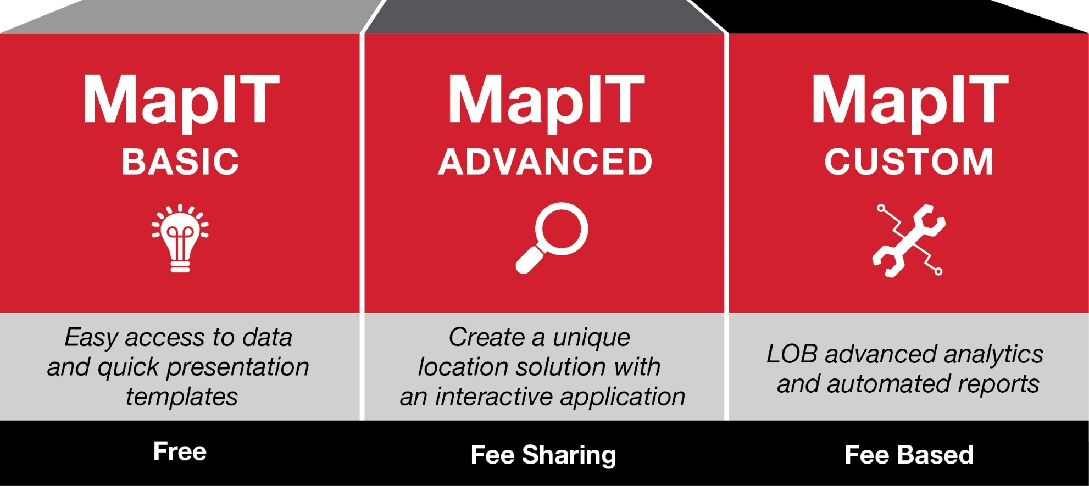
MapIT will accelerate and change how to win new business

Slide 44
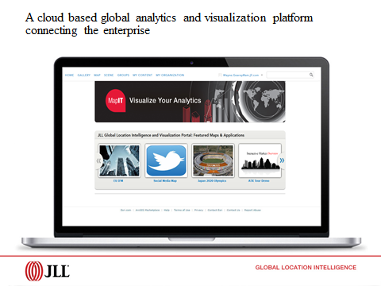
JLL Location Intelligence Dashboard Examples
We provide a shared LI platform to upload data in a visual platform that allows the client to conduct further analysis on the deliverable.

Slide 45
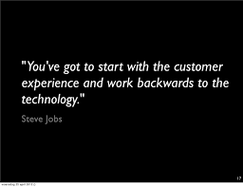

Slide 46
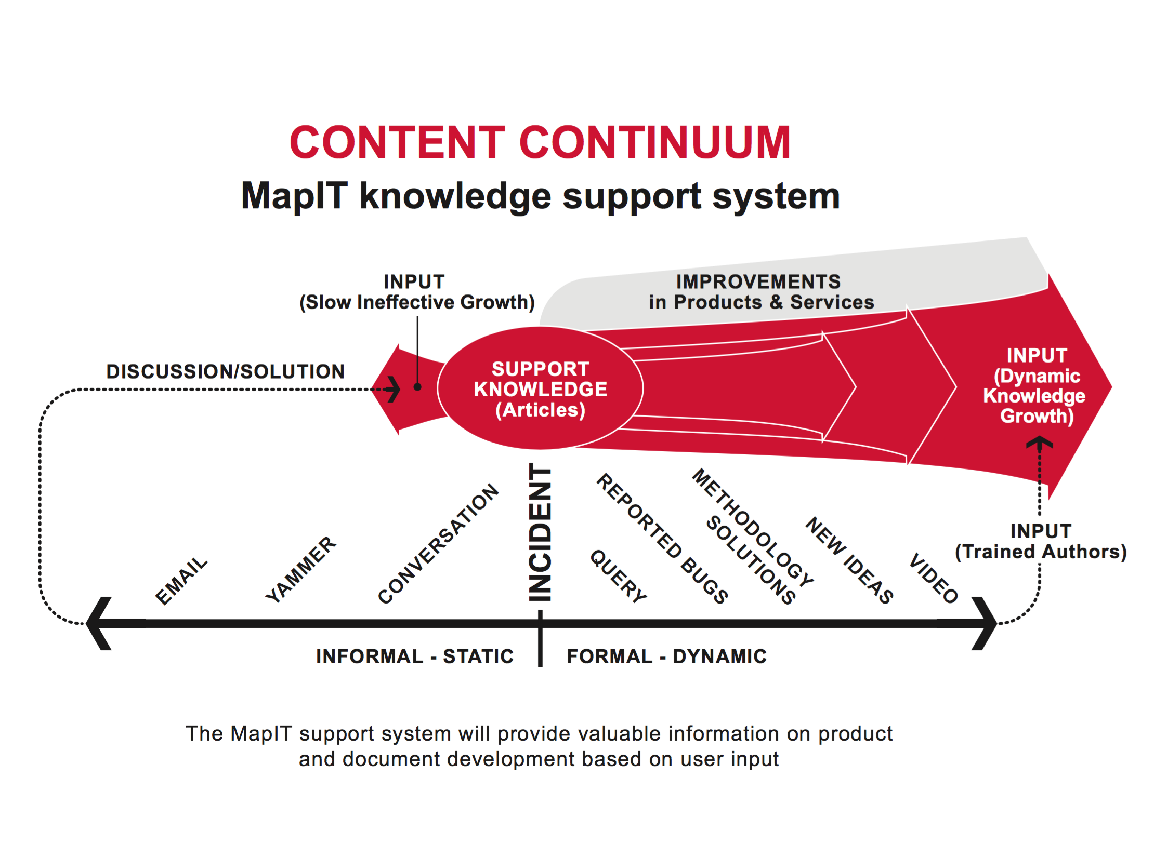

Slide 47
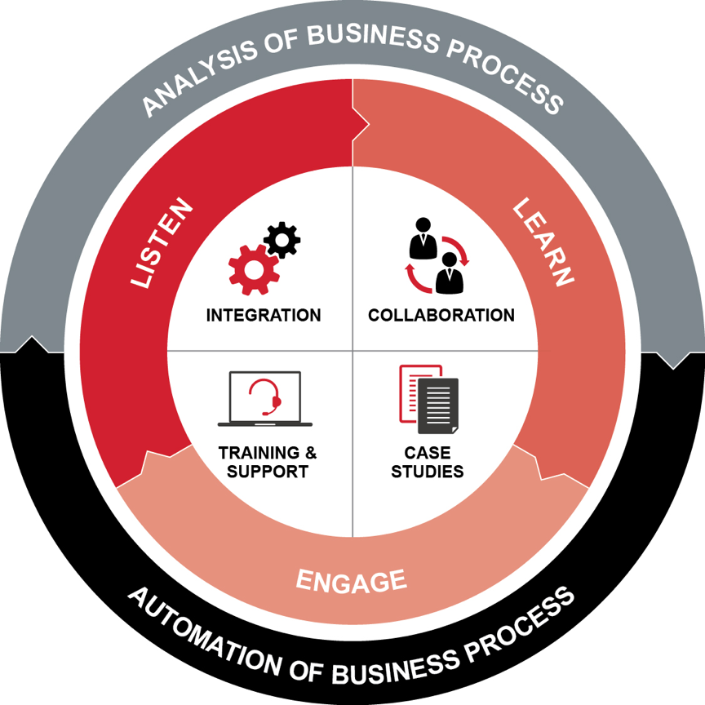
Enterprise approach to using GIS technology

Slide 48
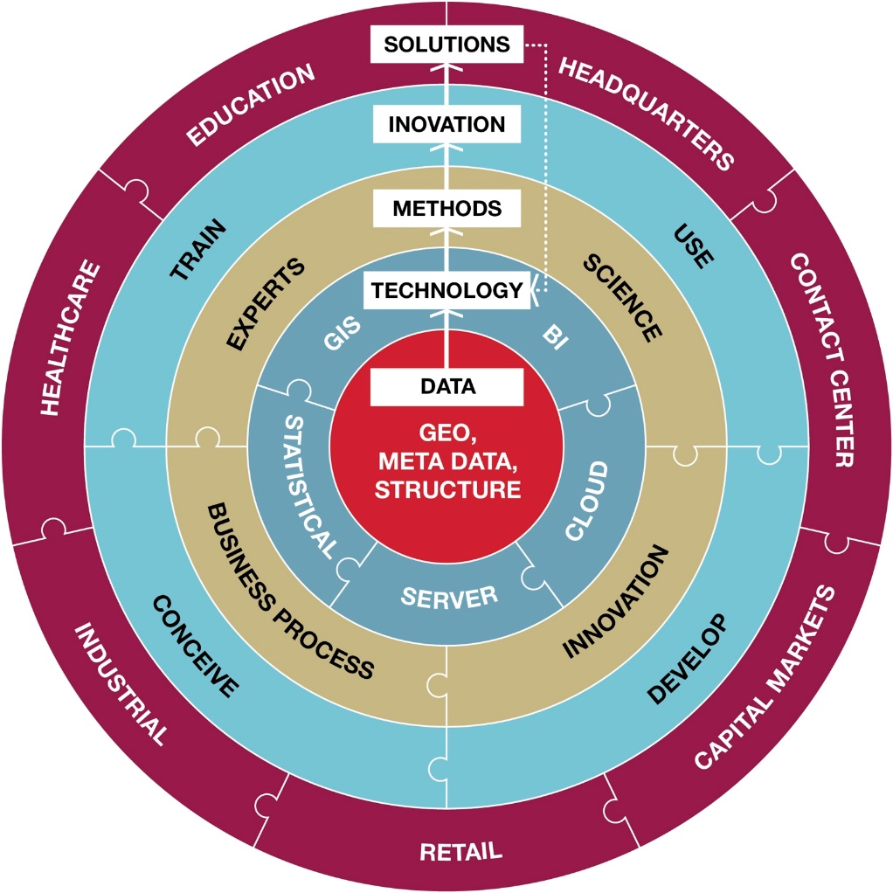
Advancing Strategic Decisions
Capturing, sharing and collaborating across the enterprise.

Slide 49
Summary
Real estate is about Location
Geographical data offers information on people and places and can be contextually analyzed to determine a geography of opportunity.
What is the story we can tell the real estate client

Slide 50
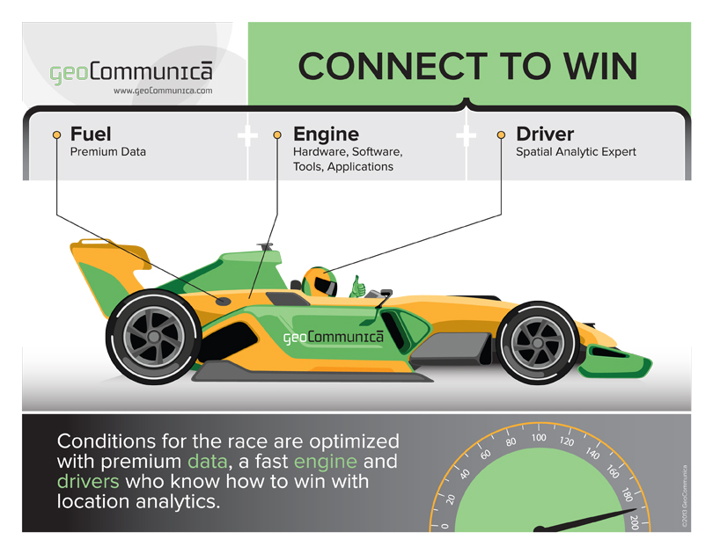
Notes:
As a geo-technology consultant, I conducted a technology data audit to understand what data is being used, what tools run the analytics and who the experts are. The results led to an awareness of a disconnected enterprise with redundant data and software licensing costs, along with various levels of training throughout the global organization.
This is not a plug and play game.
You need to think about how you are connecting LI investments to lines of business and how those lines of business are communicating with each other---- just like a winning Formula One pit crew.
The reason why Jones Lang LaSalle hired me was because this is a breakneck race for speed to insight. They know it is critical to connect the right data, people and tools to win market share.
Whether you are a global organization or mid sized, with any location intelligence investment, you too need to know: How good is your car?

